Slide 1
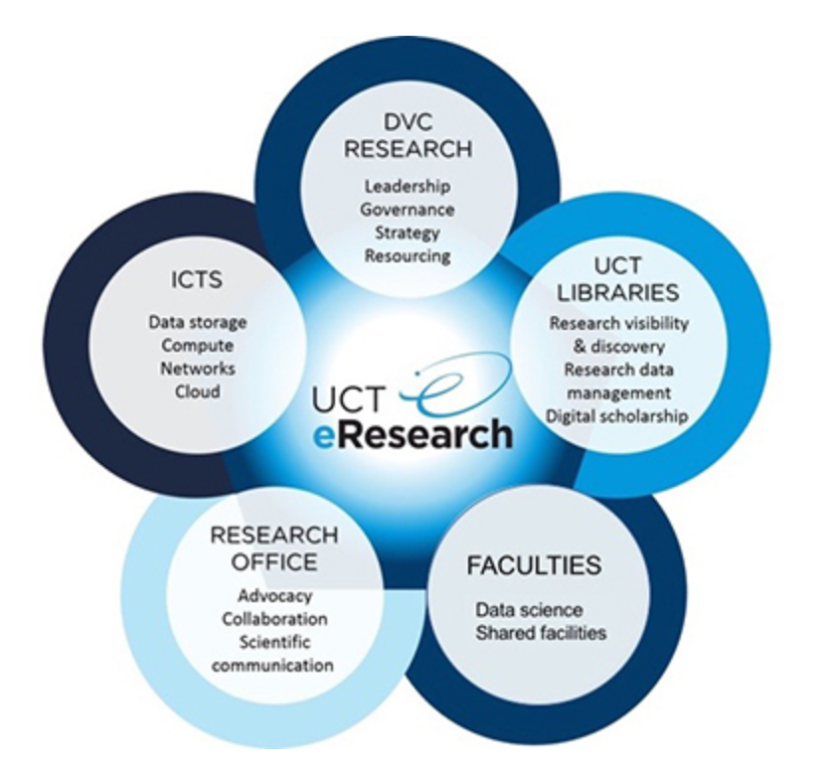
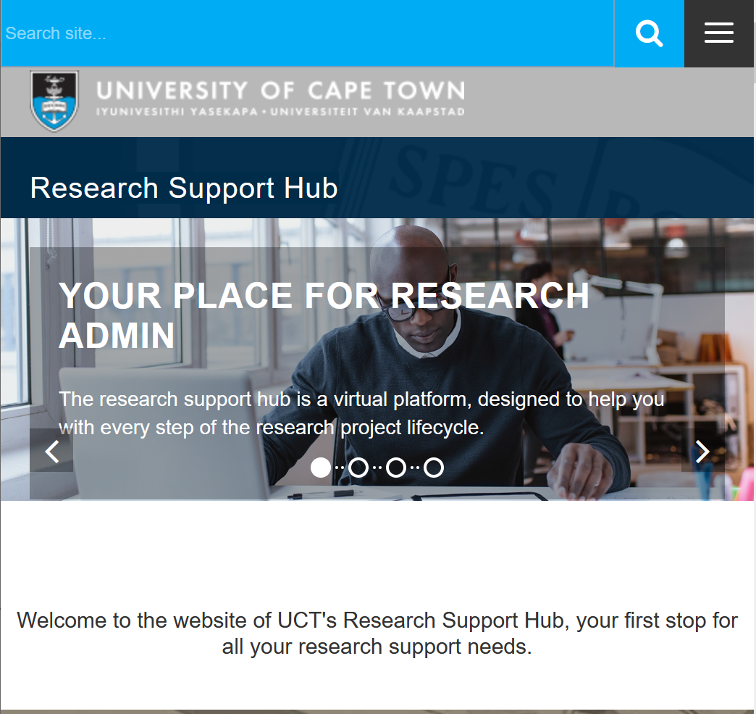
Re-imagining Systems and Processes to support our research-active, research-excellent UCT
Transforming UCT’s Research Support, esp. finance & HR services |  | Building knowledge hubs for research support
 | Digital Resources and e-research |  | Developing the pre- & post-awards knowledge hub
Digital humanity repositories
The Stats Hub
Towards Open Ethics
Field-work cooperative
DataFirst

Slide 2
Research Support Transformation project
Reasons for the RST Project:
UCT Research has grown exponentially over the last decade, but the research support capacity within the University has not grown at the same rate
UCT Research support capabilities (people, processes, systems, finances, equipment) are not sufficiently aligned to the changed Research landscape. Importantly, they are not easy to navigate.
Many support processes are retrofitted from Teaching and Learning and, as a result, are not necessarily fit for purpose for the Research endeavour
The growth of inter- and transdisciplinary research together with global and continental partnerships, and more inter- department and interfaculty interaction, requires new ways of working, to be effective including new policies, procedures, processes, and authority levels
UCT runs the risk of Researchers leaving the University due to cumbersome processes (in particular within Finance and HR)
Research entities are employing more support staff on their own budgets meaning research capacity and budget is being compromised
This Project assesses UCT’s research support systems and implications of growth, to position UCT research to flourish and grow facilitated through effective and efficient research support.

Slide 3
A transformational journey of this nature is not a quick fix and as such
the RST project has undergone a number of different phases
RST Project Timeline:
2021: Research Finance Task Team established- interviews with 10 key research groups
Q1 2022: Quick Hit Project launched to focus on “low hanging fruit” e.g. removal of signatures on forms, eRA notifications etc.
2022: Design Phase of the RST Project
2023: Implementation Phase of RST Project
Key to the success of the Project is fully understanding the issues as they affect the researchers.

Slide 4
Researchers at UCT can be broadly divided into 4 categories
Summary of key concepts/ideas:
Individual Researchers (Emerging and Established) | Teams with Dominant PIs | Integrated Teams | Large Complex Research Groups
No individual research support Limited shared resources | No individual research support | Probably has research support infrastructure Shared research resources, built and used by team Significant soft-funded component typical | Appoint own dedicated research administrative support staff (usually with funder budget)
Reliant on Centre and UCT support
Providing their own research administration support within UCT’s structures
The research support available to PIs and the methods of accessing said support differ depending on which category researchers fall into and per faculty.

Slide 5
Breakdown of researchers and research funding varies per faculty
Breakdown of research funding and PIs per category (2019):
Grouping | Health Science% | Humanities % | Science % | Humanities % | EBE % | Humanities % | Commerce % | Humanities % | Law % | Humanities % | Humanities% | Humanities % | CHED % | Humanities %
 | PIs | Rand Value | PIs | Rand Value | PIs | Rand Value | PIs | Rand Value | PIs | Rand Value | PIs | Rand Value | PIs | Rand Value
Individual researchers | 133 (41%) | R58,4m (6%) | 247 (82%) | R79,8m (28%) | 106 (56%) | R20,4m (8%) | 146 (71%) | R14,4m (9%) | 54 (100%) | R21,1m (100%) | 208 (93%) | R37,9m (59%) | 53 (98%) | R5,03m
Teams with dominant PIs | 117 (36%) | R310,0m (32%) | 36 (12%) | R96,1m (34%) | 7 (4%) | R10,2m (4%) | 28 (14%) | R49,5m (32%) | 0 | R0m | 7 (3%) | R8m (12%) | 1 (2%) | R0m
Integrated teams with multiple researchers | 52 (16%) | R137,4m (14%) | 13 (4%) | R20,2m (7%) | 71 (37%) | R118,7m (46%) | 33 (15%) | R92,2m (59%) | 0 | R0m | 9 (4%) | R18,5m (29%) | 0 (0%) | R0m
Big complex research groupings | 22 (7%) | R451,2m (47%) | 6 (2%) | R86,0m (30%) | 6 (3%) | R107,9m (42%) | 0 | R0m (0%) | 0 | R0m | 0 (0%) | R0m (0%) | 0 (0%) | R0m
Total | 324 (100%) | R957,7m (100%) | 302 (100%) | R282,1m (100%) | 190 (100%) | R257,8m (100%) | 207 (100%) | R156,1m (100%) | 54 (100%) | R21,1m (100%) | 224 (100%) | R64.5m (100%) | 54 (100%) | R5,0m (100%)
Note: Information included in this table is only for 2019 funds which are research related and for fund centers still open in 2022.
The research focus for each faculty, and therefore their support needs are different.

Slide 6
The initial focus of the Project was on the Strategy workstream, the
main aim of this workstream was to hear the needs of end users
Strategy workstream methodology:
Categorisation of researchers
The support needs of researchers within the University vary based on stage in research career, nature of research, source of funding and whether researchers work individually or in teams, so a ‘one size fits all’ approach to research support is not appropriate. Researchers within all the faculties were clustered into groupings based on nature of research activity
Survey
A survey was sent to identified people, representing each cluster across the 7 faculties. The survey response rate was excellent and researchers/research administrators provided valuable input and insights.
Workshops
A series of 21, ninety-minute workshops were held to discuss the survey results in more detail and to identify support needs and understand the awareness and appropriateness of the existing support capabilities.
Feedback to providers
The results of these surveys and workshops were presented to the management teams from the various research support divisions and steps have been taken to address the issues and challenges either at a project level or directly at management level
Feedback to researchers
Communication has been sent to researchers who completed the survey to notify them of management comments and any changes that will/have been made.

Slide 7
Units located throughout UCT responsible for research support
UCT’s research support infrastructure:
It was clear from the survey and workshops that researchers do not know who, and how, to access the appropriate research support.

Slide 8
The survey and workshops allowed for big ticket issues to be identified and prioritised
Priority issues in order of priority:
Implement a fit-for-purpose financial management system
Revise all HR policies and procedures to be applicable and supportive of the University’s Research (especially soft-funded)
Unpack the cost recovery model to provide transparency on ICRs and how they are used – with potential for re-thinking aspects
Fix the PG funding process, system and staffing
Acknowledge and recognise immense value Research brings to the Institution
Unpack the research project life-cycle and its support needs (pre- and post-awards) Introduce workflow into all priority research support processes
Compulsory induction training for all emerging researchers
Design interactive Research website listing services and contact people
Develop processes, policies and procedures that support and promote interdisciplinary research
Improve support for research post graduate students and Post Doctoral Research Fellows (including international)
Many of these priority areas have been on the drawing board for years with little to no meaningful follow up action.
Notes:
Sue here I think speak to the pain points (but we position it more positively than listing everything they complained about).

Slide 9
The initial focus was on “quick hits” implemented relatively quickly
Removal of signatures
Non-value adding signatures have been removed from the following forms: Fund and Fund Center opening/changing, S&T, Requesting and Clearing Advances, Invoice Requests, Receipt Requests, Credit Notes and Customer creation
eRA notifications
Revised email notifications for all modules on eRA. Subject lines of the emails now indicates what requires ACTION or only for INFORMATION. Included in the emails is HTML formatting and links to the various records.
Employment equity
A revised Employment Equity Guidance Note for Recruitment requires all staff who serve on selection committees to do training and does away with the need to find EE reps to serve on the committee
Repetitive projects
Revised DOA
A quotation template has been developed and rolled out in units where they do analytical tests. These quotations do not need to go through the pre-award process and can come directly to RC&I which considerably expedites the process
Developed a template for University-wide HR related processes which can be delegated from final authority to a nominee to save time associated with the recruitment process
Some examples of ”quick hits” implemented:
These ”quick hits” addressed some of the key frustrations, but other issues required more systemic change.

Slide 10
The project has successfully addressed a number of priority research support issues as identified (1/4)
Finance related issues:
Financial Reporting
Developing the Research Finance Gate for detailed reporting, customized for funders (in pilot)
Reviewing other tools e.g. IDU, other SAP models, Power BI
Use of foreign currency hedge fund
Fund to service exchange losses from EU ICR top-slicing
Funding flows understood and developed into an infographic
Exchange rate risk
Finance
Lack of transparency wrt.research funding flows
Conversion of the “Foreign Exchange Risk Management (FERM)” guidelines into a UCT Exec approved policy
Current FC and ICR approach and policy is under review- includes looking at the setting of Faculty ICR targets
Insufficient support for grants from big funders e.g. EU
Information repository on key funders- pre & post award
Establishment of an expert knowledge base on key funders compliance requirements and budgeting
Remodelling and appropriately capacitating central research support services
KEY:
Complete
Work in progress

Slide 12
The project has successfully addressed a number of priority research support issues as identified (2/4)
HR related issues:
Waiver of Advertisement Policy allows for motivations for people specifically earmarked for certain research projects to be appointed without following the University’s lengthy appointment process
Delays in appointing research staff
Automation of T1 appointment letters
Revised policy on Fixed Term Contract Appointments- recruitments for < 6 months can be made without advertising
Conditions & benefits for SFARS
Leave policies and procedures don’t cater for research
Study and Research Leave Policy has been revised and research staff now qualify
Research staff on academic conditions of service can apply for annual leave online
The SFARS Policy has been developed and approved by Council. This policy provides for better financial support and funding security for soft-funded researchers through a variety of mechanisms
HR
The SFARS Policy implementation is underway
Naming conventions of researchers
Research contracts retrofitted from Teaching and Learning
HR in consultation with DVC: Research and Internationalisation to understand research specific information required in the contracts to amend them accordingly
HR Client Services working on a proposal for the naming conventions of researchers from Research Fellow all the way up to Principal Researcher
Better visibility and access to HR support for researchers
Faculty research support proposal
HR working with CMD to develop factsheets to be referenced on new Research Support Hub website
Roadshows and workshops in faculties
KEY:
Complete
Work in progress
Notes:
Law Faculty only individual researchers- need to provide support for them (especially emerging)

Slide 13
The project has successfully addressed a number of priority research support issues as identified (3/4)
Governance related issues:
No research represent-ation on formal UCT structures
Established a research executive to build capacity to allow research to be responsive through the URC Executive
Establishment of an interfaculty committee to oversee all ethics applications related to non-bio medical human research
No interfaculty ethics committee
Lack of an active voice for research within the University
Established a research forum which meet each semester and is the seat for airing research ideas, opportunities and for building new approaches
Established a Director’s Forum for representation from accredited research centres and institutes
Governance
Grand Challenges Programme
More opportunities for researchers to network and connect
Need for ongoing monitoring of research compliance
Establishment of a forum to monitor compliance related matters (e.g. BioSafety, Ethics, Health and Safety, Conflict of Interest, POPIA, Carbon Offset Policies etc.)- take over from task team
KEY:
Complete
Work in progress
Notes:
Law Faculty only individual researchers- need to provide support for them (especially emerging)

Slide 14
The project has successfully addressed a number of priority research support issues as identified (4/4)
Postgraduate and Post Doctoral support related issues:
Lack of a dedicated online space for UCT postdoctoral students
Hosted focus group to design PD hub- staggered implementation to address critical gaps first
Postdoctoral Association (PDA) being resuscitated
Postdoctoral Research Day
PDRF sub-committee working through postdoctoral rights and support
Visibility and voice of postdoctoral researchers
PG and PDRF
Bench-marked and in process with designing a “PG life-cycle” support tool for the PG hub
Build series of postdoctoral events and networking opportunities
Assess benefit of dedicated postdoctoral space
Automation of the Financial Aid Process
Implementation of the revised PayWorks Package
Review of PGFO’s processes was conducted (BPR & RACI)
Delays in payment of funding to Post Graduate and Post-Doctoral students
KEY:
Complete
Work in progress
ICTS build schedule for automations- planned rollout
Notes:
Law Faculty only individual researchers- need to provide support for them (especially emerging)

Slide 15
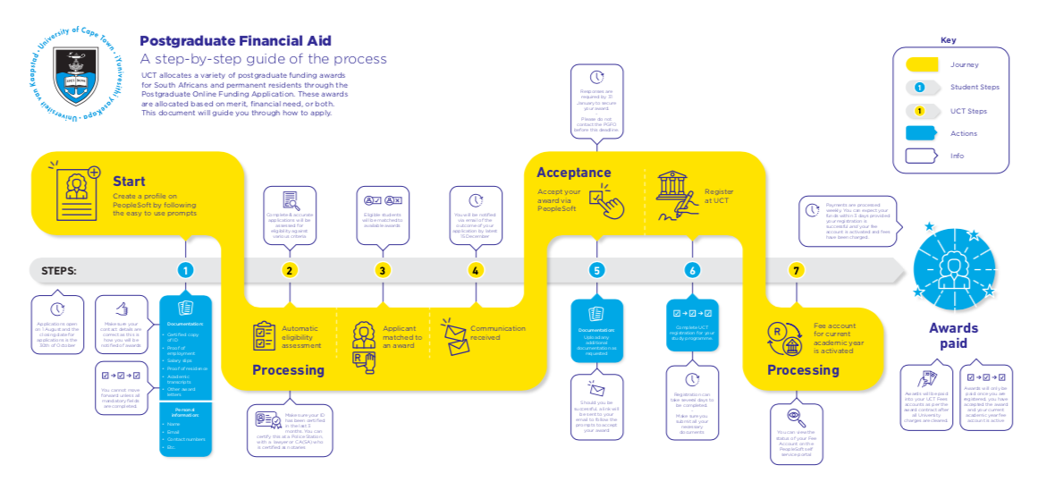

Slide 16
Much of the research support required exists in the University. . .
UCT’s research support infrastructure:
. . . the solution needs to focus on connecting researchers with the support.

Slide 17
Survey results highlighted the need for a faculty-based path-finder who can assist researchers in sourcing the appropriate support
Researcher quotes:
“If you are new to UCT, you are not aware of all the support services and who to contact regarding your own research projects. Consulting the website is overwhelming. Informative/orientation sessions would be useful.”
“I find it hard to differentiate what goes via which of the many many central offices. It's all very vague and blurry.”
“We need dedicated people to work with to develop relationships.”
“The first time I heard of Central Research Finance was at the last Faculty Board meeting.”
“I'm not 100% sure what exactly the Research Office does, there are so many departments that it is not always who does what, or who to contact.”
“UCT is the first research institute I have worked at that does not have inductions for its various systems.”
“Market research support service more actively. This would really be useful in orientating new academic staff.”
“It would be enormously helpful if there were dedicated research support personnel in each faculty to make the most of the services on offer.”
“Sometimes it's hard to get information on all things available to me as a researcher”
“When we need information for funders or collaborators you get sent from pillar to post trying to get the information and/or support in order to continue with research projects.”
“We would appreciate having an assigned person who we could build a strong relationship with who understood the specificities of the research we conduct”.
“Better website with user-friendly interface/ explanation on how research works at UCT and what services the research office offers.”
“Offices need to reach new staff members and explain what they do, where they are based and how to interact with them…”
“Document standard operating procedures (SOPs).”
“A single point of contact for all my needs.”
The Project has designed 2 key solutions to assist researchers in accessing appropriate research support – one at a central level and the other at a Faculty-level.

Slide 18
We are building a visible pathway of appropriate research support across all aspects of the grant lifecycle
Research support providers across the grant lifecycle:
Pre-and-Post Award Research Hub intersecting and streamlining the work of
the Research Office, Research Contracts and Innovation (RC&I) and Central Research Finance (CRF)
Grants seeking
Grants submission
Grants contracting
Grants-post award management
Grants closure
Executive Director or Deputy Director Research
International Grants Hub (IGH)
Executive Director or Deputy Director Research
International Grants Hub (IGH)
Research Contracts and Innovation (RC&I)
Central Research Finance (CRF)
8x Deputy Dean Research
8x Faculty Finance Officers
Director: Research Contracts & Innovation (RC&I)
8x Faculty Finance Officers
Director: Central Research Finance (CRF)
Director: Research Contracts & Innovation (RC&I)
Executive Director: Research
8x Faculty Finance Officers
Director: Central Research Finance (CRF)
Director: Research Contracts & Innovation (RC&I)
Executive Director: Research
8x Faculty Finance Officers
Clear articulation across the project life cycle to streamline and communication steps and functions.

Slide 19
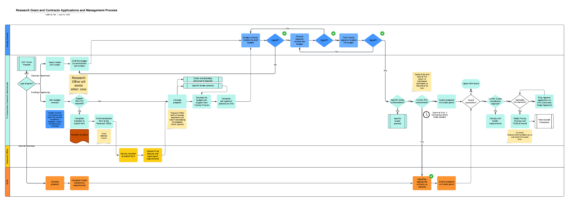
Research project grant life-cycle
Unpacking each step – pre-award process: still to validate

Slide 20
Research project grant life-cycle
Unpacking each step – post award process: still to validate

Slide 21
We are building a visible pathway of appropriate research support across all aspects of the grant lifecycle through 3 key initiatives
Methods for improving research support across the value chain:
KNOWLEDGE HUB:
WEBSITE:
FACULTY-BASED RESEARCH SUPPORT:
The hub will serve as an expert knowledge base for researchers when applying for grants to easily access information of the full project life cycle, funder requirements and compliance, thereby reducing potential risks to UCT and researchers
A project to build a consistent website across the research endeavour, clearly highlighting the support services and how researchers can access them is underway.
A research support hub in each faculty office will be networked to the pre- and post award hub and central research offices to facilitate flow of information and services, with associated SLAs
The aim is a clear articulation across the project life cycle to streamline and communication steps and functions.

Slide 22
The project continues to work on the high priority areas
RST Implementation Phase focus areas:
Project Management
Change Management
Funding Flows
PG Support
Pre-and-Post Award
Systems
Inter-Disciplinary Research
Service Value Analysis (SVA)
Organisational Redesign
KNOWLEDGE HUB:
WEBSITE:
FACULTY-BASED RESEARCH SUPPORT:
Researcher and research administrator involvement will continue to be paramount as the project progresses.

Slide 23
Q & A

