Slide 1
Library Workshop for NRF Rating
2021
Amina Adam
amina.adam@uct.ac.za
021 650 3871
Notes:
Good afternoon everybody and welcome to the Library Workshop for NRF Rating.
My name is Amina Adam and I am the Principal librarian for SEL.
At this workshop we hope to provide you with assistance when applying for NRF rating.

Slide 2
Topics
Bibliometric services
Indicators for NRF Rating application
The role of ORCID
Library Checklist for NRF Rating Application
Questions & Answers
Conclusion
Notes:
This session have two major parts: presentation and one-on-one session with a librarian
During the presentation, we would cover the following topics:
Bibliometric services available to you through out the year
We would relate bibliometric indicators to your research outputs so that you can showcase your work for the NRF Rating Application
We would also emphasise the role of ORCID in simplifying and reducing manual processes for your current and future reporting needs.
We will briefly take you through, the Library Checklist for NRF Rating Application so that you can ensure all your needs are met throughout your application process.
Then we will open the floor for questions and answers.
At the end we will conclude the first part and provide guidance on how to proceed with the one-on-one session

Slide 3
Bibliometric services
The service enables you to showcase research excellence and impact using bibliometric indicators.
Bibliometric indicators are quantitative metrics
Research output count
Citations based indicators
Altmetrics (Attention metrics)
Notes:
The service will enable you to showcase your research excellence and impact by using bibliometric indicators when applying for grants, researcher rating and promotion.
Increasingly, funders and research evaluating organisations are requiring to show evidence of return on investment to support their decision making.
Bibliometrics is a quantitative analysis on published contents including:
the number of your contributions,
visibility indicators of your research outputs and
indicators that show how much users are engaging with your outputs.

Slide 4
Bibliometric services
Assistance is provided in
setting up author profiles and IDs
collating relevant metrics and generate evidence of research impact reports
interpret metrics to motivate for applications (bibliometric narratives)
Notes:
Additionally, we assist you with
setting up your author profiles and IDs including ORCID iD record.
collate indicators for your publications to generate evidence of research impact reports
assist you with interpreting the indicators to support your applications.
Now will hand over to Faadiel who will talk about indicators for the NRF Rating Application.

Slide 5
Bibliometric indicators (metrics)
Faadiel Latief
faadiel.Latief@uct.ac.za
021 650 4353

Slide 6
Author metrics
Total citations received
h-index
Output count
Average citation
Metrics
Visibility
Impact
Journal metrics (visibility)
Quartiles / percentiles of JIF & CiteScore
Article metrics
Citations
Altmetrics: Media coverage, policy documents, patents

Slide 7
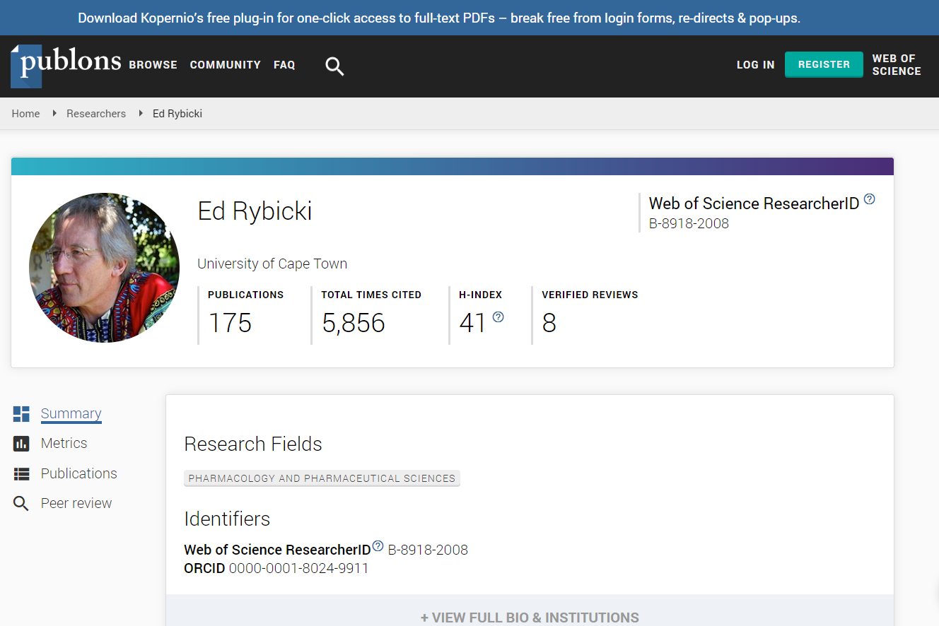

Slide 8
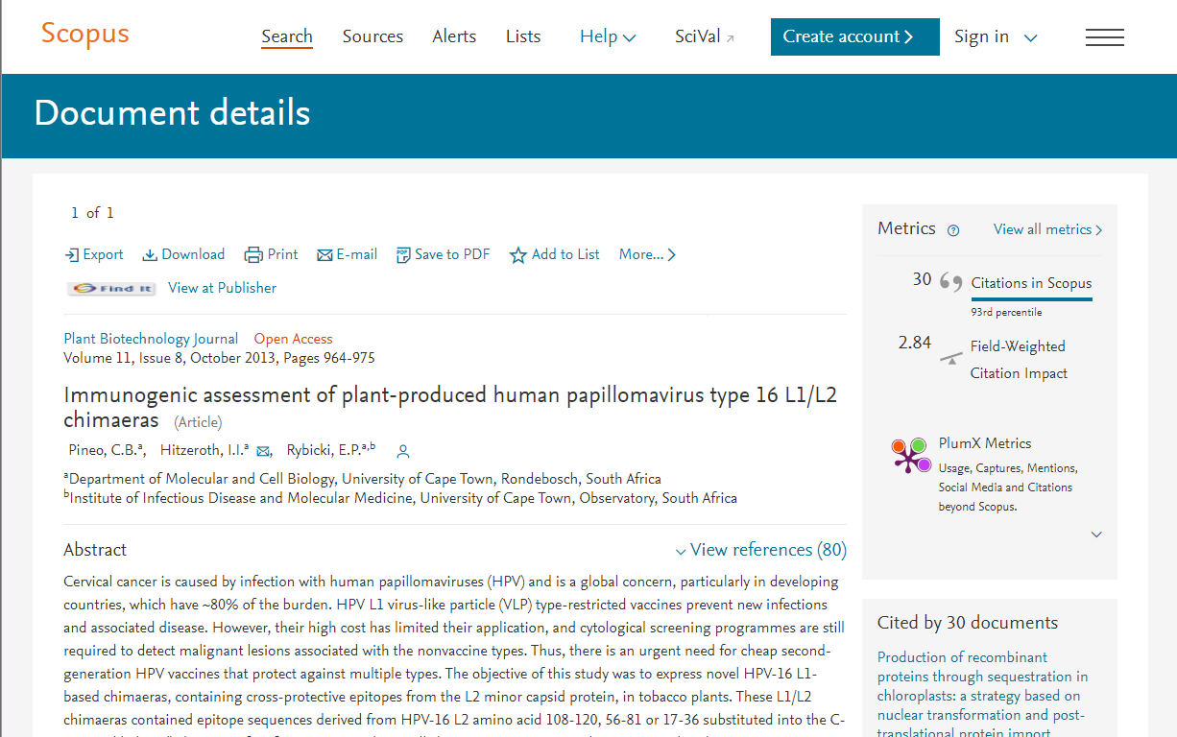

Slide 9
Author metrics
Citations
h-index
Output count
Average citation
Sources of metrics
Scopus
Publons (Web of Science)
Google Scholar
ORCID (total output count)
Journal metrics (visibility)
Quartiles / percentiles of JIF (Journal Impact Factor) & CiteScore
Sources of metrics
Scopus
Journal Citation Report (JCR)

Slide 10
Article metrics
Citations
Altmetrics: Media coverage, policy documents, patents …
Sources of metrics
Scopus
PlumX (from Scopus)
Web of Science
Altmetric.com (from Dimensions)

Slide 11
Strength | Weakness
An objective estimation of research | Affected by time, discipline and document type
Visibility | Reason for citation in question
Influence | Dependent on database coverage
Quality (to some degree) | The need to combine

Slide 12
Research evaluation attributes & metrics

Slide 13
Research evaluation attributes
Productivity
Volume of research outputs
Metric: output count
Use in NRF form: CV - Personal Profile, Application – Self-assessment
Research Excellence
Highlights on prestige and visibility
Metric: journal metrics
Use in NRF form: CV - Personal Profile, Application - Best Research Outputs in last 8 Years, Self-assessment

Slide 14
Research evaluation attributes
Research Impact (academic)
Influence in academia
Metric: citations received, h-index, average citation (citation per publication)…
Use in NRF form: CV - Personal Profile, Application - Best Research Outputs in last 8 Years, Self-assessment

Slide 15
Research evaluation attributes
Research Impact (society)
Influence in society
Metric: Altmetrics: media coverage, policy documents, patents, access count (usage) …
Use in NRF form: Application - Best Research Outputs in last 8 Years

Slide 16
Research evaluation attributes
Innovation
Your unique findings
Metric: topics
Use in NRF form: CV - Personal Profile, Application - Best Research Outputs in last 8 Years
Collaborations
Institutional, National, International
Metric: Percentage collaborations
Use in NRF form: CV - Personal Profile

Slide 17

The Role of ORCID
Awot K. Gebregziabher
Awot.Gebregziabher@uct.ac.za
021 650 4399

Slide 18



The role of ORCID
ORCID: Open Researcher and Contributor IDentifier
Digital platform
Provide you 16 digit lifelong ID
xxxx-xxxx-xxxx-xxxx
Connects your ID with your
research outputs digitally

Slide 19


The role of ORCID …
Increases your visibility and accuracy of your research related information
Allows you to connect and collect your authorised information to and from
Publishers, funding organisations and institutions (UCT)

Slide 20
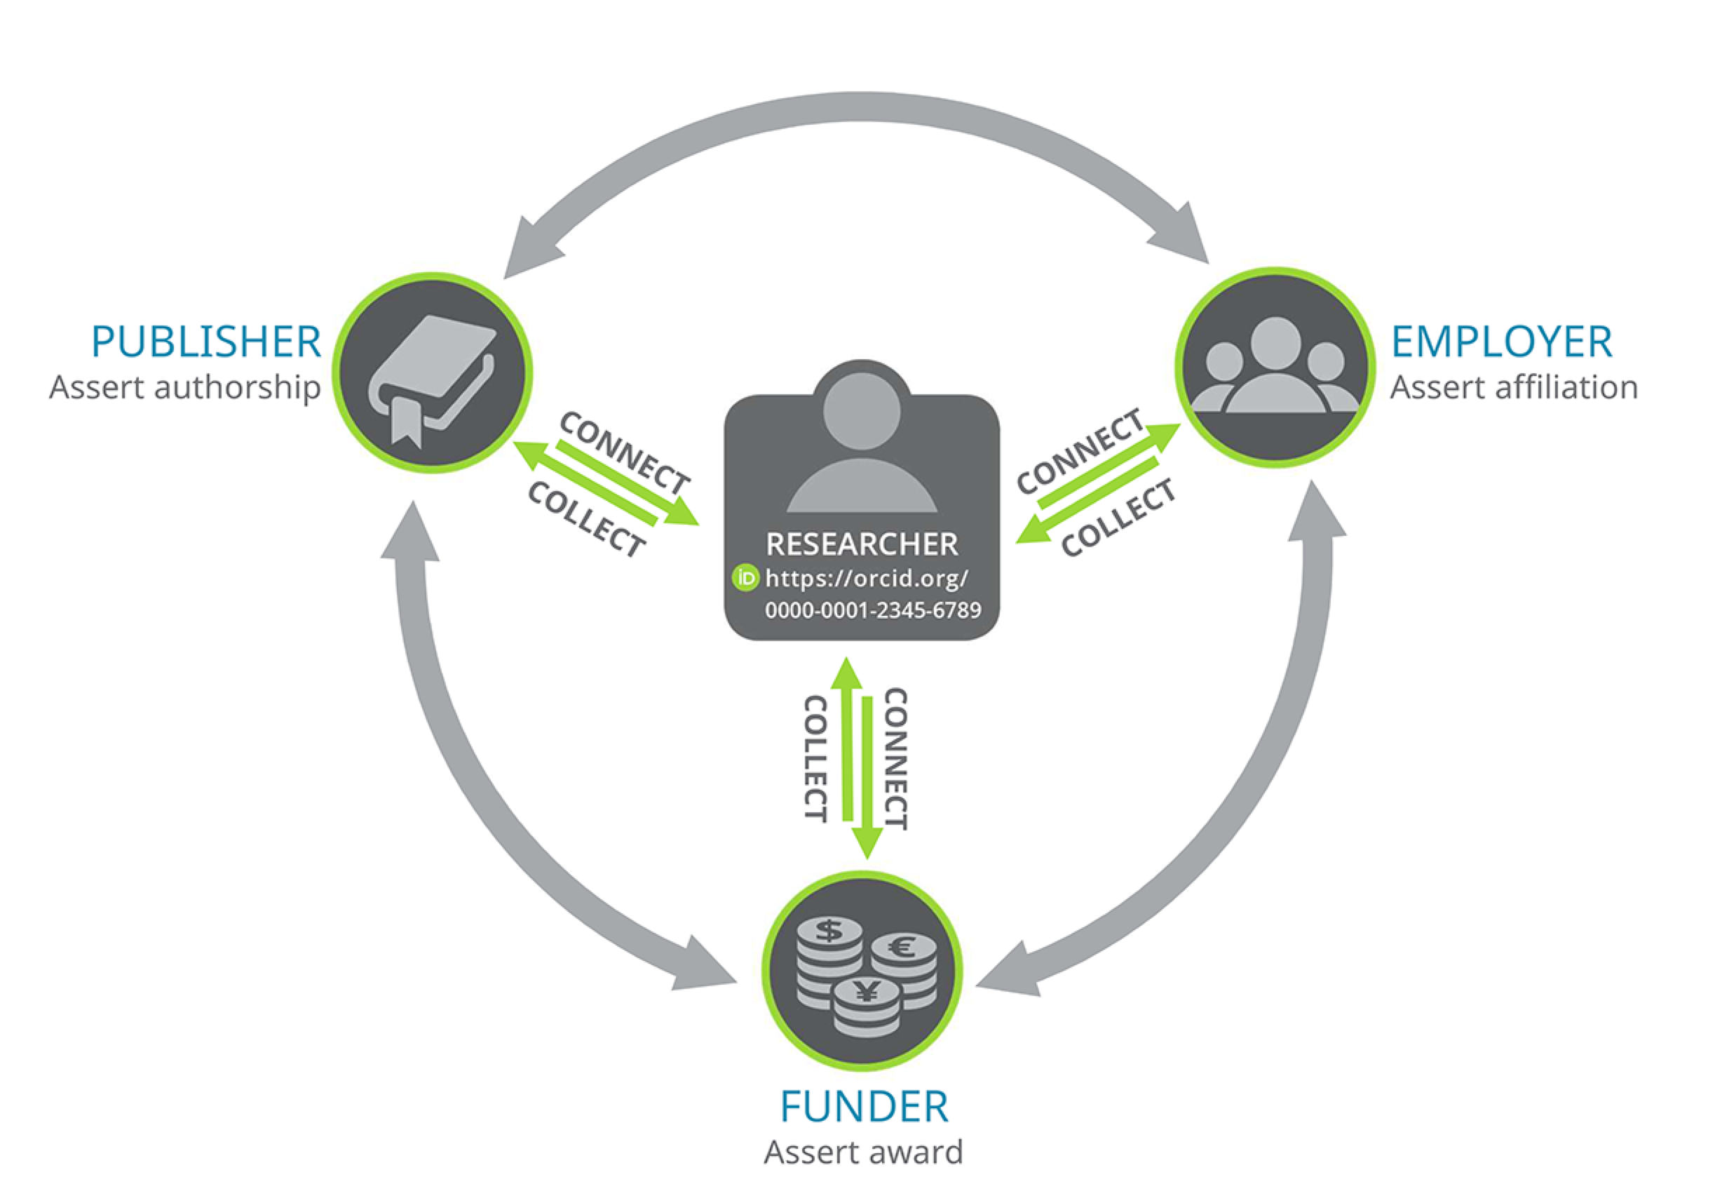
Image adapted from https://orcid.org/content/collect-connect

Slide 21
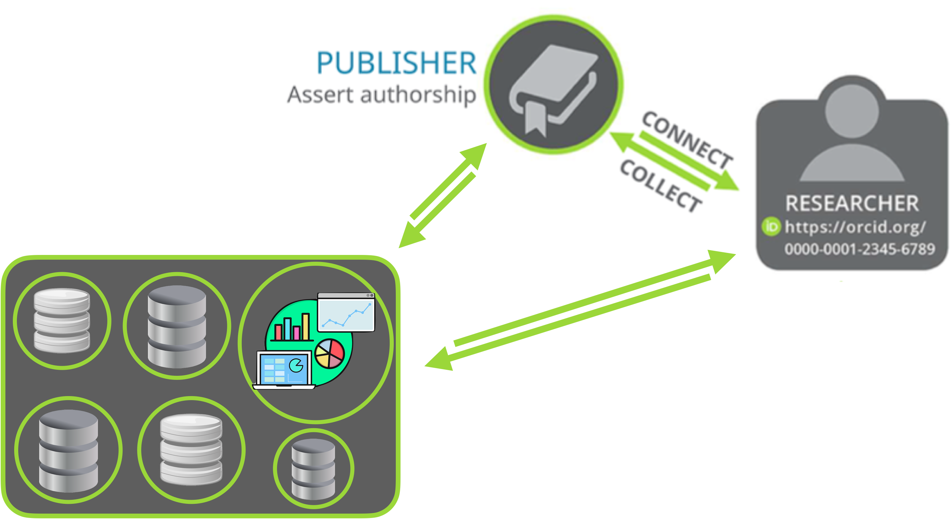





CONNECT
COLLECT
Citation Databases
and
Analytical platforms
Image adapted from https://orcid.org/content/collect-connect

Slide 22
The role of ORCID …
Why should I allow ORCID iD to connect and collect?
To create a reliable content in your ORCID iD record
as publishers update your ORCID iD record
institutions and funding organizations to update information
** You have full control over
what information to share
with whom to share: trusted organisations or individuals

Slide 23

The role of ORCID …
Authorised platforms are trusted
Organisations or individuals
How do I connect and collect platforms with my ORCID?
By authorising trusted links from ORCID or from integrated platform
Example: Scopus, Publons (Web of Science ResearcherID), a journal…

Slide 24
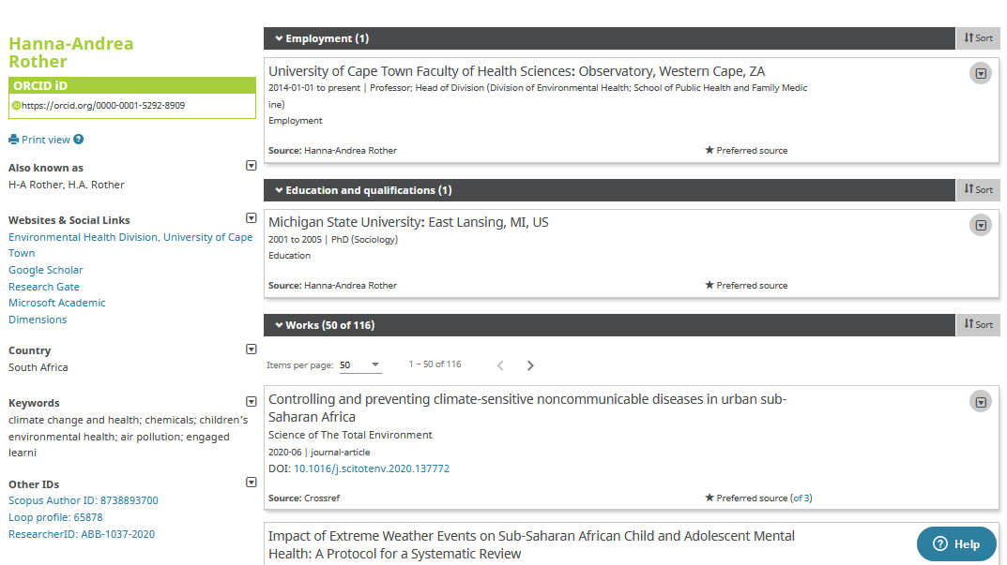

Slide 25
The role of ORCID …
For more information and guidance check the following
ORCID at UCT library guide
ORCID page at Research Support Hub
Contact your Faculty Librarian for one-on-one assistance

Slide 26
NRF Rating Checklist
Jeremiah Pietersen
Jeremiah.Pietersen@uct.ac.za
Anthea Paulsen
Anthea.Paulsen@uct.ac.za

Slide 27
Library support for NRF rating applications
Provide support using bibliometric data
Provide guidance on appropriate metrics
Provide support in identifying, if applicable, contribution to niche research areas
Notes:
The role of the library is to provide support in the researcher’s application for an NRF rating which includes providing bibliometric and other relevant assistance in support of the application. The Libraries will provide guidance in terms of what is the most appropriate metric to use in support of the application and will also provide support in identifying, if applicable, contribution to niche research areas. In preparation of yourself, the researcher, for engagement with the librarian, here is an outline of the library support that we can provide to add value to your application.
Three sections: CV, Application and Narrative culminating in a checklist that you can use to track your progress through the application.

Slide 28
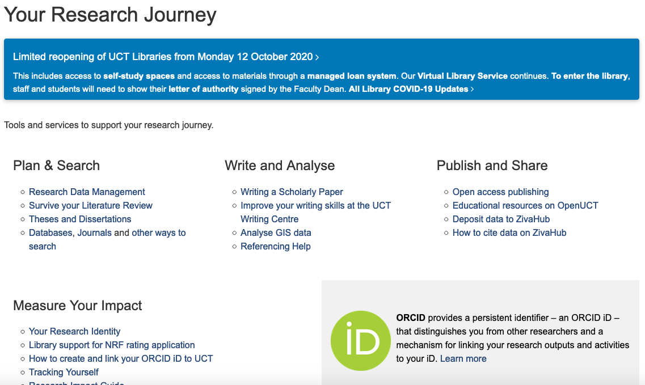
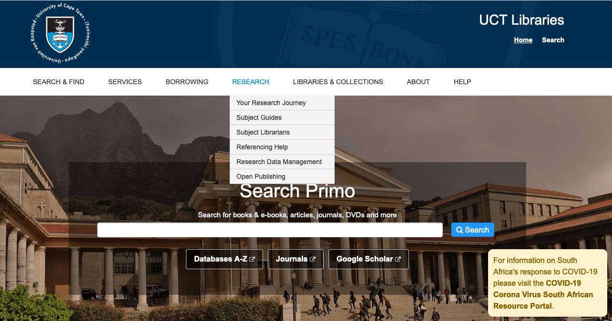
Finding the document
Libraries’ website: http://www.lib.uct.ac.za/lib/research

Slide 29
1. CV
Researcher accounts:
ORCID
Publons
Google Scholar
Web of Science and Scopus
Integrations of ORCID with:
UCT’s eRA
Researcher ID/Publons (Web of Science)
Author ID (Scopus)
Notes:
Conduct searches for publications on CrossRef and DataCite; and,
Export publications from Google Scholar (to do this, the researcher will have had to create an account, claim publications and clean up duplications).
To facilitate a comprehensive and seamless extraction of bibliometric data, it is critical to have the appropriate author profiles set up and up to date.
The researcher is requested to provide the librarians with a comprehensive up to date CV of publications.

Slide 30
2. Application
The section on Research outputs can be informed by the researcher’s ORCID profile. Under Additional details, the Google Scholar h-index information can be taken from the Google Scholar profile.
Notes:
In this section more space is given for the researcher to supply a narrative, with an option of attaching additional documentation.

Slide 31
2. Application (cont.)
Best five research outputs in the last 8 years:
Metric information of publications provided by the researcher
this could be innovative outputs or novel knowledge produced in niche or highly specialised research areas; or,
A metrics report of the best five publications based on the metrics available on SciVal, Scopus, Web of Science and other relevant platforms that collect bibliometric data.
Notes:
The librarian can provide metric information of publications that the researcher provides – this could be innovative outputs or novel knowledge produced in niche or highly specialised research areas; or,
The librarian can prepare a metrics report of the best five publications based on the metrics available on SciVal, Scopus, Web of Science and other relevant platforms that collect bibliometric data. Additionally, the librarian can also look at comparable metrics like field-weighted citations (Scopus) or field citation ratio (Dimensions).

Slide 32
2. Application (cont.)
Brief description of completed research and self-assessment of research output:
A basic bibliometrics report of the last 8 years can be generated to inform the description
The librarian can provide more detail for notable works as informed by the researcher; perhaps multiple publications emanating from one research project (including supervision of masters or PhD projects from said research project).
Notes:
Brief description of completed research and self-assessment of research output:
A basic bibliometrics report of the last 8 years can be generated to inform the description
A basic report will include data from Scopus, Web of Science and Google Scholar
Scopus and Web of Science provide citation data from trusted sources while Google Scholar index more sources that either platform, giving it the advantage of being able to give a truer sense of citation impact than Web of Science and Scopus for some disciplines.
The librarian can provide more detail for notable works as informed by the researcher; perhaps multiple publications emanating from one research project (including supervision of masters or PhD projects from said research project).

Slide 33
Narrative : purpose
Narratives are informed by both the quantitative bibliometric data collected as well as information supplied by the researcher.
This feeds into the narratives required in the ‘Application’ section of the NRF rating application, or an additional narrative can be created to append the whole application.

Slide 34
Narrative : questions to assist the process cont…
Are you able to frame the impact of your research?
Has your research resulted in new research areas? What is it that have you contributed to the advancement of your discipline/field?

Slide 35
Narrative: questions to assist the process
Have you had unique or special collaborations?
Is there anything of significance about your research or your research career that is not necessarily evident in traditional metrics?

Slide 36
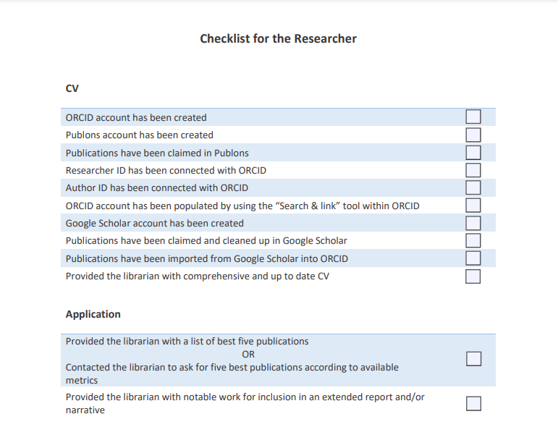

Slide 37
Note:
In order to get the maximum benefit of this service offering, we advise that you allow the Libraries at least 2 weeks to assist you in your application.
You can contact the Libraries by getting in contact with the Principal Librarian responsible for supporting your faculty.

Slide 38
Details for the Principal librarians
CHED: Glynnis Johnson – glynnis.johnson@uct.ac.za
Commerce: Glynnis Johnson – glynnis.johnson@uct.ac.za
Engineering and the Built Environment: Amina Adam – amina.adam@uct.ac.za
Health Sciences: Brandon Adams – brandon.adams@uct.ac.za
Humanities: Alex D’Angelo – alexander.dangelo@uct.ac.za
Law: Sadiq Keraan – sadiq.keraan@uct.ac.za
Science: Amina Adam – amina.adam@uct.ac.za

Slide 39
Summary
Library support for NRF rating applications
Read beforehand as preparation
Narrative
Checklist – track progress

Slide 40
Thank you
Jeremiah.Pietersen@uct.ac.za
Anthea.Paulsen@uct.ac.za

