Slide 1
OpenAIRE Guidelines for Content Providers - new Metadata Application Profile for Literature Repositories
Jochen Schirrwagen, UNIBI Andreas Czerniak, UNIBI Pedro Principe, UMINHO
Notes:
OpenAIRE Guidelines for data providers: new Metadata Application Profile for Literature Repositories

Slide 2
Agenda
OpenAIRE Interoperability Guidelines Eco-System
Objectives for Lit. Repository Guidelines v4
Introduction to the Application Profile
Implementation Aspects
in Repository Platforms
in OpenAIRE Infrastructure
Support & Dissemination
Notes:
https://www.openaire.eu/item/openaire-internal-webinar-for-noads-and-consortium-partners-literature-repositories-guidelines

Slide 3
Overview of OpenAIRE Interoperability Guidelines

Slide 4

Diverse Types of Research Results
Publications
Datasets
Software
Other Research Products
Article
Preprint
Report
…
Dataset
Collection
Clinical Trials
…
Research Software
…
Service
Workflow
Interactive Resource
…
Institutional/
publication repositories
Data repositories
Software repositories
Other Products repositories
Journals/
publishers
Notes:
we consider institutional / publication repositories of type “hybrid” as they “can” host all kind of research products

Slide 5
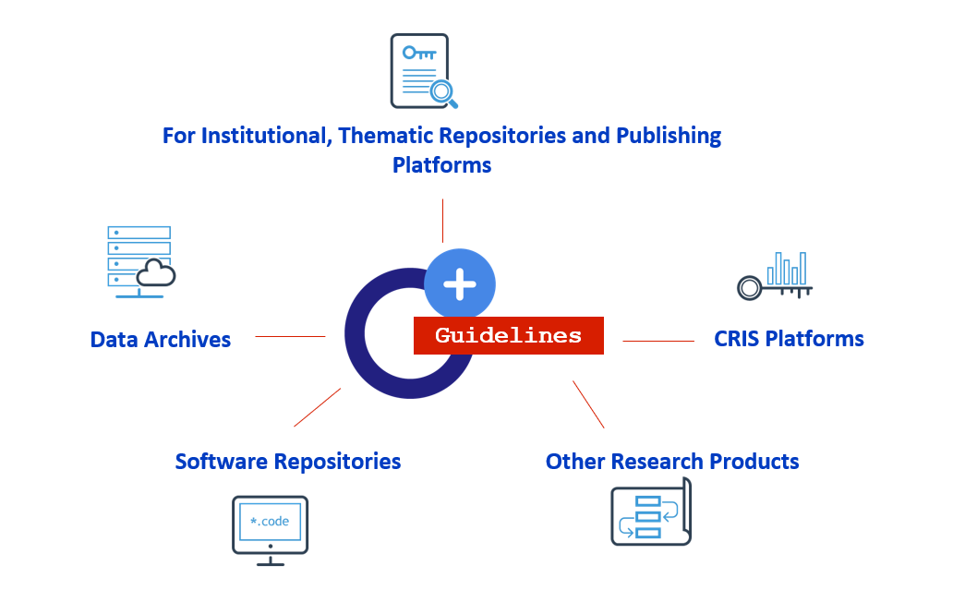
OpenAIRE‘s Guidelines for Open Science Content Providers
https://guidelines.openaire.eu
Notes:
relation to EOSChub

Slide 6
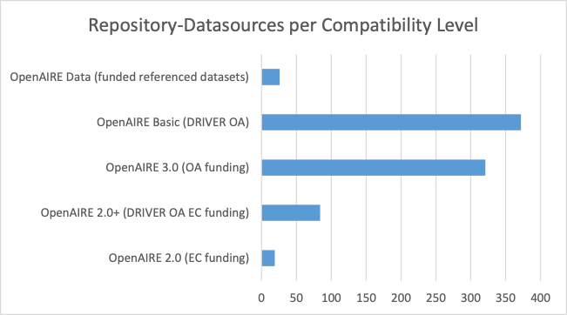
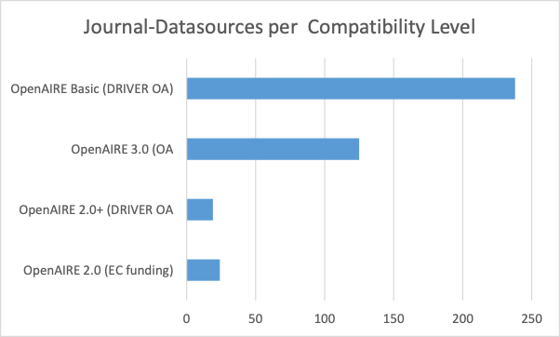
Datasources Guidelines-Compatibility
In addition: 158 repositories are collected from a compatible aggregator
In addition: 12,284 journals are collected from a compatible publisher or aggregator
last updated: Mar-2019

Slide 7
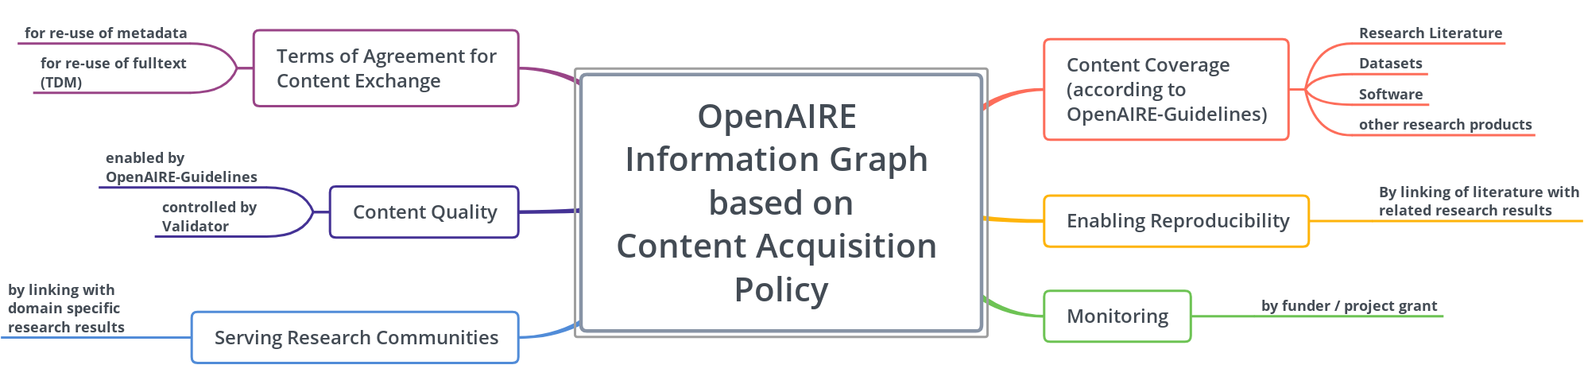
Objectives of OpenAIRE’s Aggregation Policy
Content Acquisition Policy released 05-Oct-2018, https://doi.org/10.5281/zenodo.1446408

Slide 8
Metadata describing Open Access and non-Open Access material will be included and links to other products will be resolved where this is possible (i.e. the provided PIDs have a resolver).
as stated in the Content Acquisition Policy
Notes:
The Content Acquisition Policy states that
“Open Access and non-Open Access material will be included and links to other products will
be resolved where this is possible (i.e. the provided PIDs have a resolver).”

Slide 9
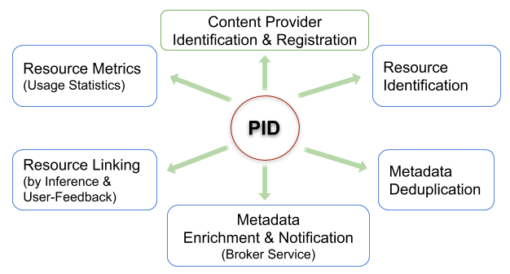
Role of PIDs in OpenAIRE

Slide 10
Guidelines v4 and Application Profile

Slide 11
What’s new
Application profil based on Dublin Core & DataCite metadata schemes
requires a new OAI metadata prefix “oai_openaire”, but requires no specific OAI-set
supports various identifier schemes for entities like authors, organisations, funders, scholarly works
uses controlled vocabularies defined by COAR (access rights, resource types, version types)
compatible with OpenAIRE content acquisition policy

Slide 12
References
Guidelines at https://openaire-guidelines-for-literature-repository-managers.readthedocs.io/en/v4.0.0/
Schema and examples on github https://github.com/openaire/guidelines-literature-repositories

Slide 13
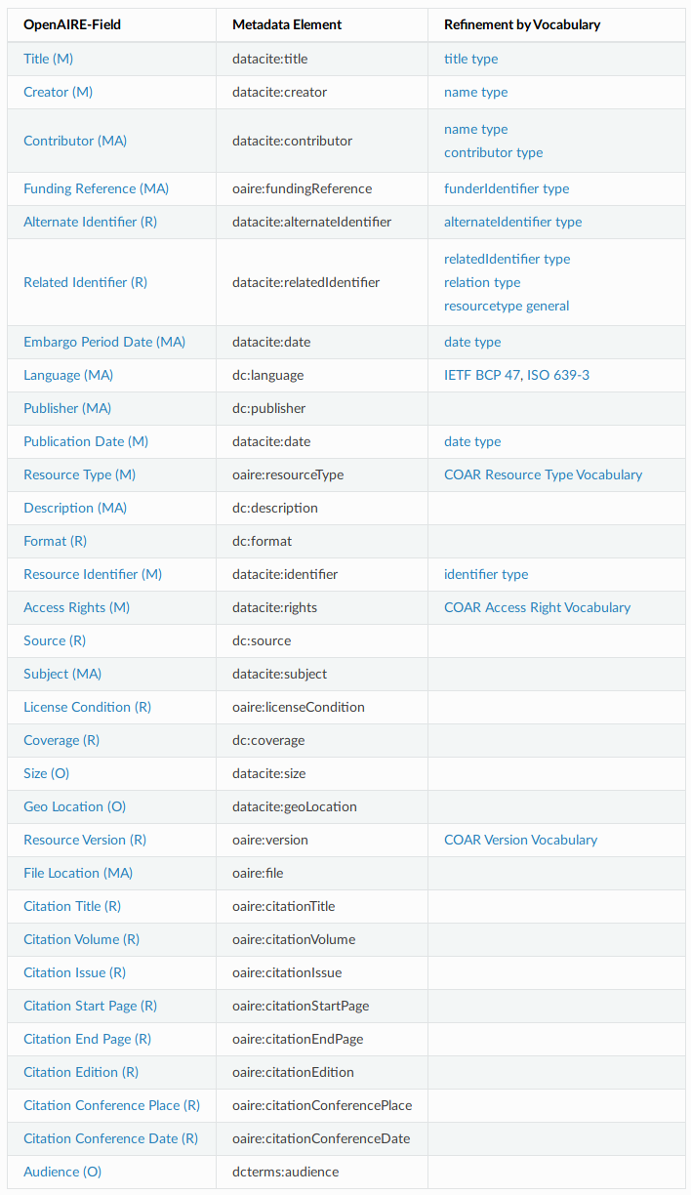
OpenAIRE Guidelines for Literature Repository Managers v4.0
Based on established standards: Dublin Core and DataCite metadata scheme
For description of textual and data publications
Application Profile
Controlled Vocabularies aligned with the other OpenAIRE Guidelines
http://dx.doi.org/10.5281/zenodo.1299203
(Released Nov-2018)

Slide 14
Metadata Goals
Goal | Metadata Groups
Discovery and Citability | Descriptive metadata
Accessibility and Reuse | Access Rights, License Conditions
Contextualization | Research Project, Linked Research Artefacts
Interoperability | Identifier for Entities, Controlled Vocabularies
Reporting | Funding Reference
TDM | File Location, License Conditions

Slide 15
Discovery and Citability I
Property | Requirement level | Granularity
Creator | Mandatory | Attributes for firstName, lastName, identifier
Publication Date | Mandatory
Title | Mandatory
Resource Identifier | Mandatory | Identifier Type
Resource Type | Mandatory / Controlled
Contributor | Mandatory if applicable
Language | Mandatory if applicable / Controlled
Description | Mandatory if applicable
Subject | Mandatory if applicable
Publisher | Mandatory if applicable

Slide 16
Discovery and Citability II
Property | Requirement level | Granularity
Source | Recommended
Coverage | Recommended
Audience | Optional
GeoLocation | Optional
Resource Version | Recommended
Citation Title | Recommended
Citation Volume | Recommended
Citation Issue | Recommended
Citation Start Page | Recommended
Citation End Page | Recommended
Citation Edition | Recommended
Citation Conference Place | Recommended
Citation Conference Date | Recommended

Slide 17
Accessibility and Reuse
Property | Requirement level | Granularity
Access Rights | Mandatory / Controlled
License Condition | Recommended

Slide 18
Reporting (to Funders)
Property | Requirement level | Granularity
Funding Reference | Mandatory if applicable | funderName, award ...
Embargo Period Date | Mandatory if applicable

Slide 19
Interoperability
Property | Requirement level | Granularity
Format | Recommended
Alternate Identifier | Recommended | identifier type
Related Identifier | Recommended | identifier type, relation type, resource type

Slide 20
Mining and Download
Property | Requirement level | Granularity
File Location | Mandatory if applicable
Size | Optional
Related Identifier | Recommended | identifier type, relation type, resource type

Slide 21
Implementation Roadmap

Slide 22
Roll out of OpenAIRE Guidelines
When | Purpose | What | Who
12-2018 | Communication | Release, Newsletter, Blogpost | Guidelines-Team
04-2019 | Training: purposes of the guidelines; how to disseminate to repo-managers; collect feedback from repo-managers | Webinar for NOADs | UNIBI
04-2019 | Support material | Guide / Factsheet / FAQs for Repository Managers per type of Guidelines | UMINHO, UNIBI
04/05-2019 | Training & support for implementation | Individual meetings with platform developers | Guidelines-Team, NOADs
05/06-2019 … | Training & configuration & practical aspects | Repository Managers | Guidelines-Team, NOADs
03/04-2019 | Implementation | Update Validator / Aggregator | Tech-Team
06-2019 | Implementation / discuss at Open Repositories Conference | Guidelines supported in Repository Platforms | Guidelines-Team and Platform Developers

Slide 23
Implementation in Repositories
Software | Supported Version | Status | Comments
DSpace | 7 (in prep.) 5 & 6 (in test) | In preparation - DSpace OpenAIRE 4.0 WG Implementations by PT repos RCAAP for v.5 | 70 days effort (WG timeline plans) Documentation will be available ASAP
EPrints | All | Contacted | May need funding via Jisc or OpenAIRE
Invenio / zenodo |  | On their roadmap
Islandora |  | Contacted
Librecat |  | Contacted
OPUS | 4 (in prod.) | Contacted
MyCoRe |  | Contacted
HAL |  | Contacted | May have very limited resources

Slide 24
Implementation in the OpenAIRE Infrastructure
Service | What | When | Comments
Validator | Ruleset for Guidelines v4 | In preparation | also required for Guidelines implementers
DataSource Registration & Update | Compatibility Level MetadataFormat
Aggregation | Transformation Rules | In preparation
Notes:
Validator
Registration
Aggregation

Slide 25
Support & Dissemination

Slide 26
Message to Repository Managers
Guidelines v4 introduces a new Application Profile
OpenAIRE coordinates implementation in major repository platforms
Let us know missing platforms which must be supported !
Validation, Registration, Aggregation in OpenAIRE according to the new Guidelines is in preparation
OpenAIRE will continue aggregation of repositories which are compatible to previous versions of the Guidelines
Upgrade to new Guidelines is recommended as it will improve metadata quality
The new CAP has come into effect (all types of research output, OA and non-OA)
OpenAIRE will organize a webinar on the new Guidelines dedicated to repository managers

Slide 27








CONTENT PROVIDERS – SUPPORT & DISSEMINATION STRATEGY (2019)
Monthly Newsletter
Guides &
Factsheets
Community
Calls
Contact repo managers
(NOADs collaboration)
Service Uptake campaign
Update Terms of use
Support users access

Slide 28
Content providers – Support & Training materials
SUPPORT MATERIALS
CURRENTLY AVAILABLE
PLANNED SUPPORT MATERIALS & TRAINING ACTIVITIES
Guides
How to validate and register your repository
How to enrich research artifacts
How to track the usage activity of your repository
Making your repository Open
Literature & Data interlinking
Webinars
Provide Dashboard – make your data count
Support materials
Guide about the new CAP (April)
Guides per type of guidelines (May-June)
Fact sheet for repository managers (update April)
Fact sheet about the guidelines (May-July)
FAQs related with the new guidelines (May-July)
Training activities
Webinar for NOADs on the new guidelines (April)
Online meetings with platforms developers
Community calls (April, May, June, Sept, Oct. Nov.)
www.openaire.eu/support

Slide 29
guidelines@openaire.eu

