Slide 1
Content Provider
Dashboard
OpenAIRE service for repository managers

Slide 2





OpenAIRE Content Provider Dashboard – what it is
One-stop-shop web service where content providers (repositories, data archives, journals, aggregators, CRIS systems) interact with OpenAIRE.
It provides the front-end access to many of OpenAIRE's backend services.

Slide 3
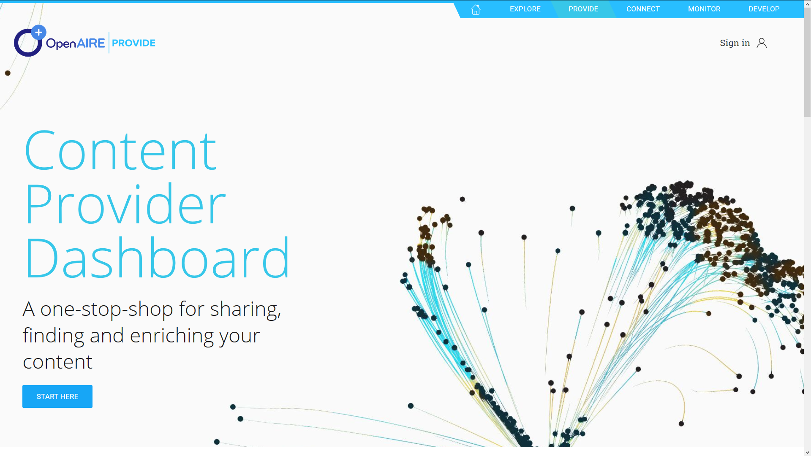




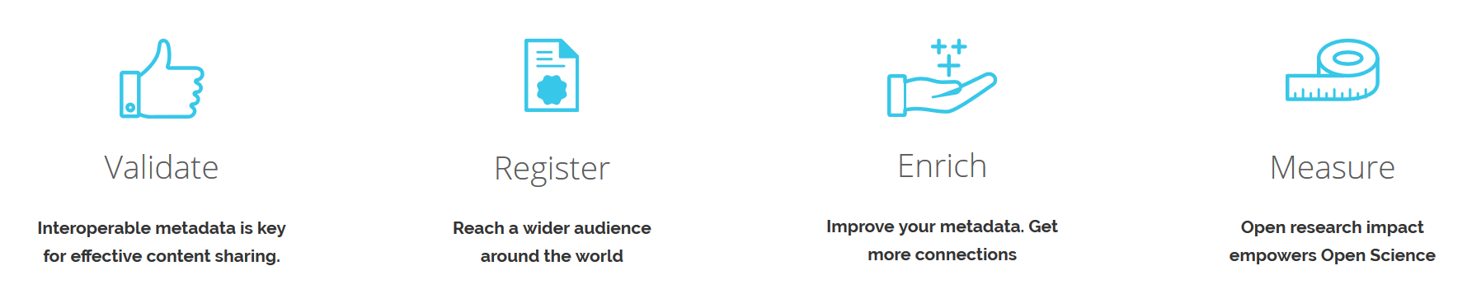
provide.openaire.eu
…

Slide 4
one stop shop for all
OpenAIRE content providers
Services for repository managers, Data Archive managers,
OA publishers…
SUPPORT, PROMOTE, ENRICH

Slide 5



Dashboard usage
TARGET USERS
Repository managers (literature, data), libraries, content providers, publishers, national aggregators.
USER BASE
800 content providers have used the registration and validation service (V1 focused on literature repositories, 1200 all types for V2).
USER VALUE
Improve repository collections and content for enhanced visibility and access. Improved institution memory. Better institution research assessment. Compliance to funder rules. Improved repository interoperability.

Slide 6
OpenAIRE Content Provider Dashboard
what it does

Slide 7
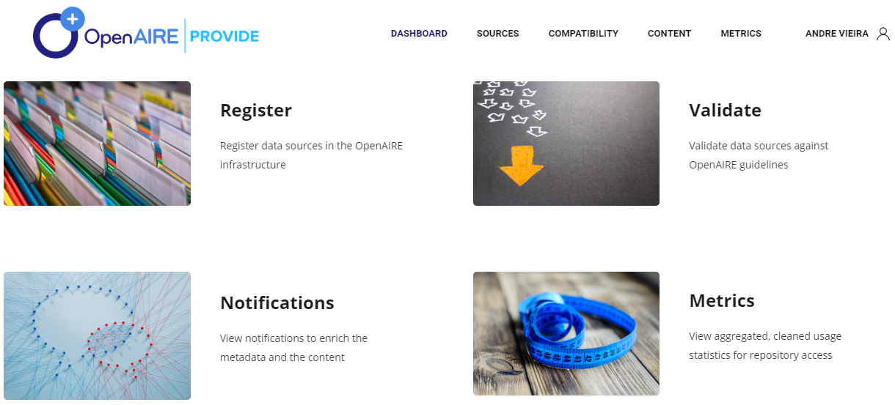
Content Provider Dashboard

Slide 8



Interoperable metadata is key for effective content sharing
Use our validation service and see how you can apply the OpenAIRE Guidelines to expose your contents using global standards.
VALIDATE

Slide 9


Reach a wider audience around the world
Register your datasource in OpenAIRE and be part of a global interlinked network.
REGISTER

Slide 10

Improve your metadata.
Get more connections
OA Broker service offers a wealth of information on scholarly communication data.
ENRICH
Find out what interests you and subscribe to enrich your records.
More & Missing events that may enrich your Repository:
Persistent identifiers
Open Access Versions
Projects
Subjects
Abstracts
  … datasets, software

Slide 11

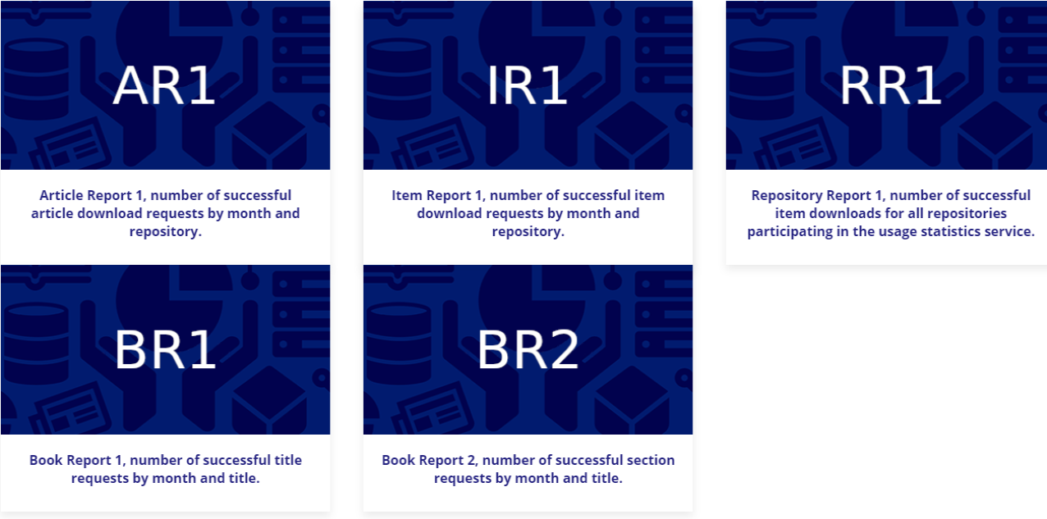
Open research impact empowers Open Science
Open Metrics service by sharing your usage data.
Get the benefit of an aggregated environment to broaden the mechanisms for impact assessment.
MEASURE
Get usage statistics reports for your datasource

Slide 12
Novelties

Slide 13
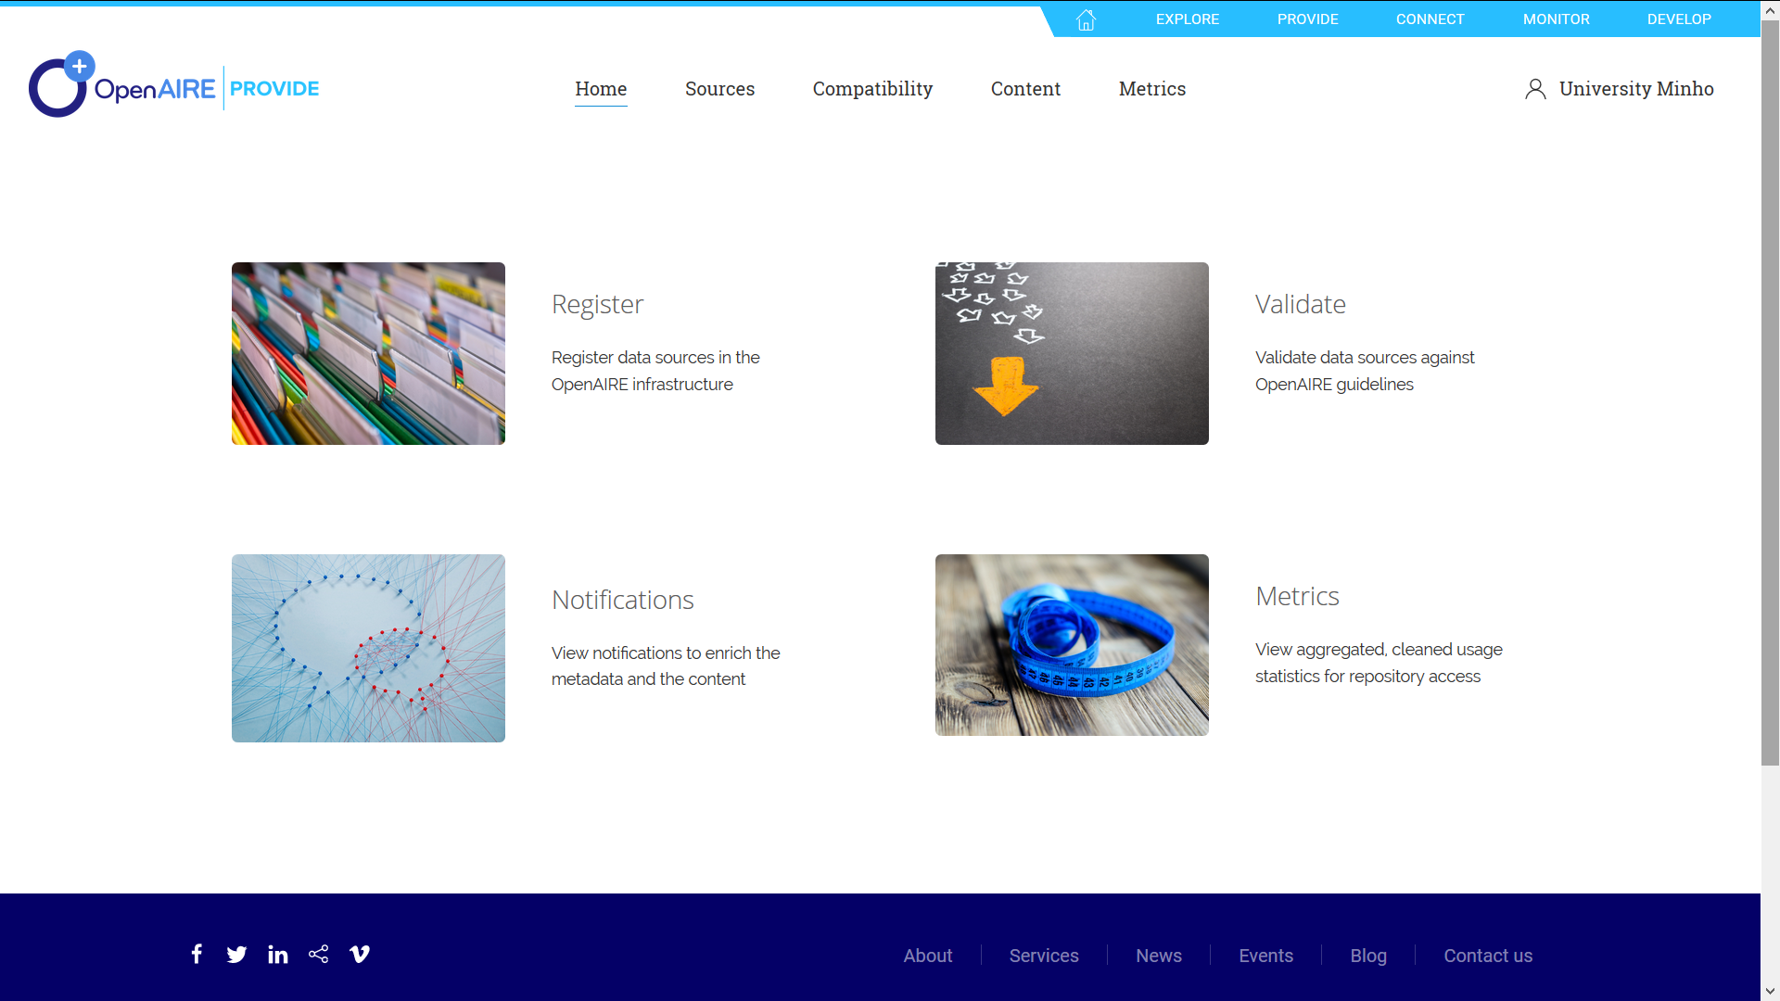
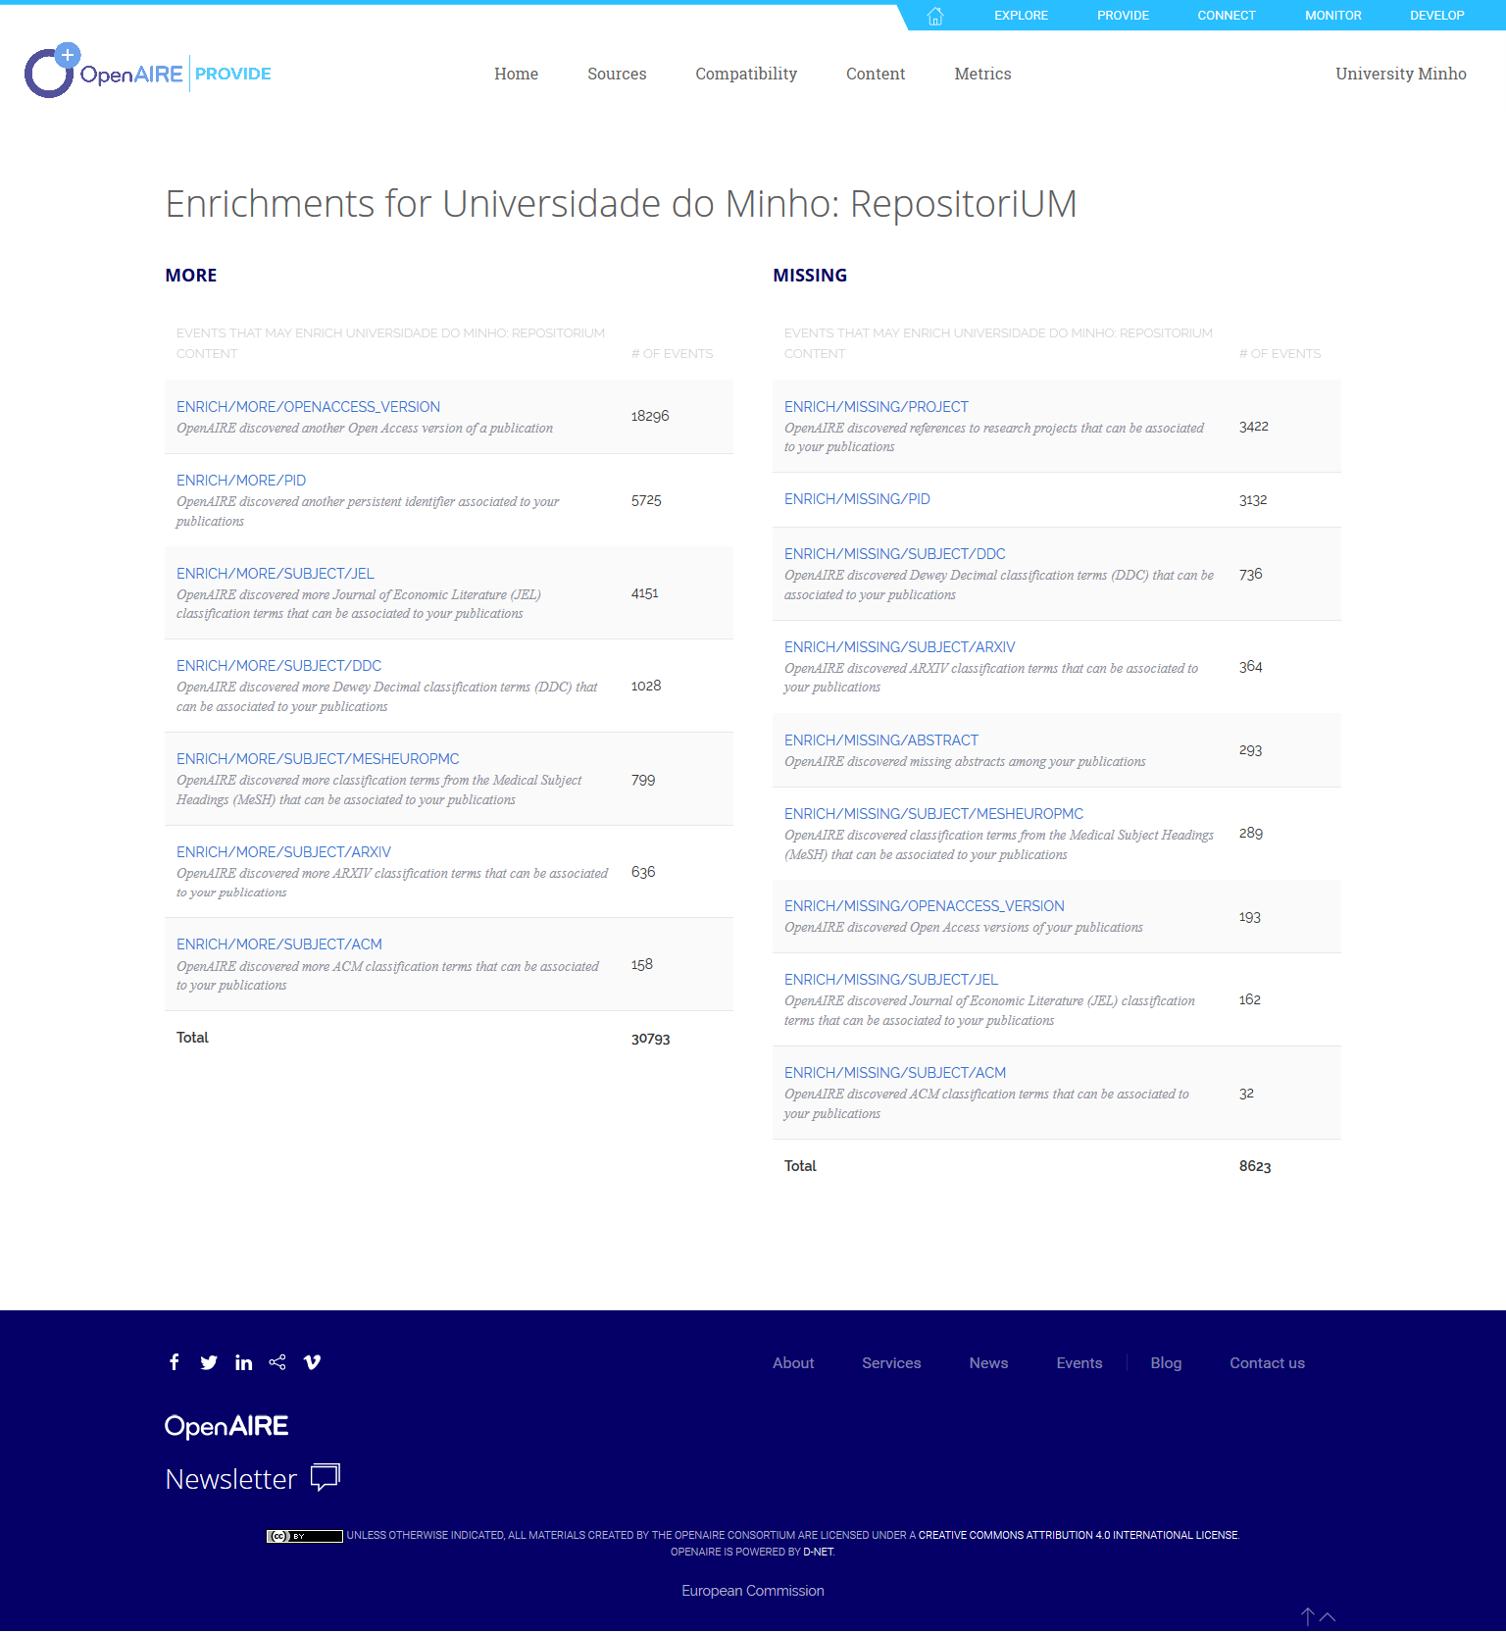
METADATA ENRICHMENTS FROM THE OPENAIRE BROKER SERVICE (monthly notifications)

Slide 14
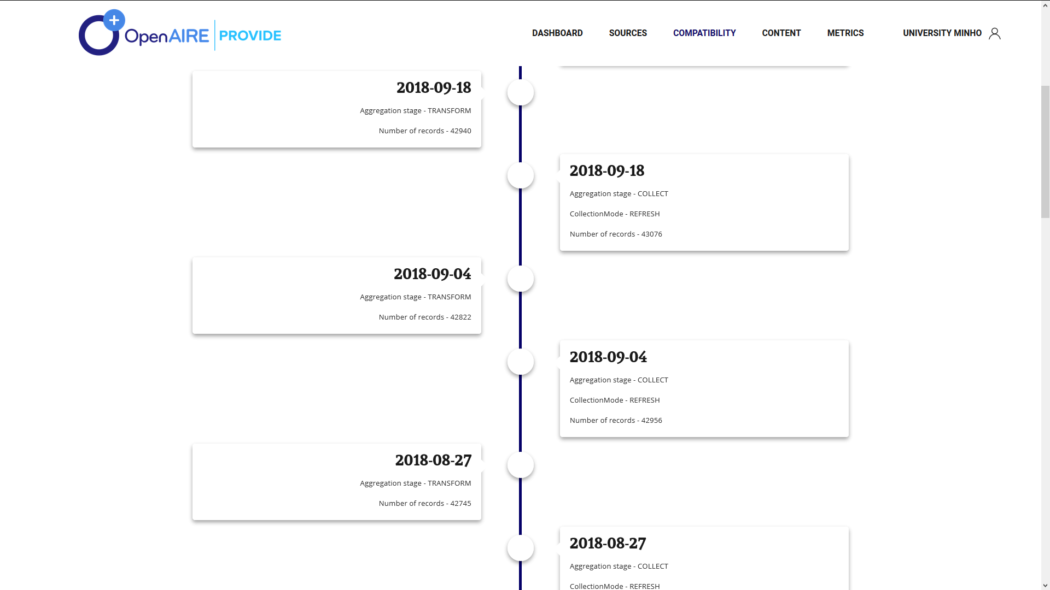
Collection monitor provides the aggregation history

Slide 15
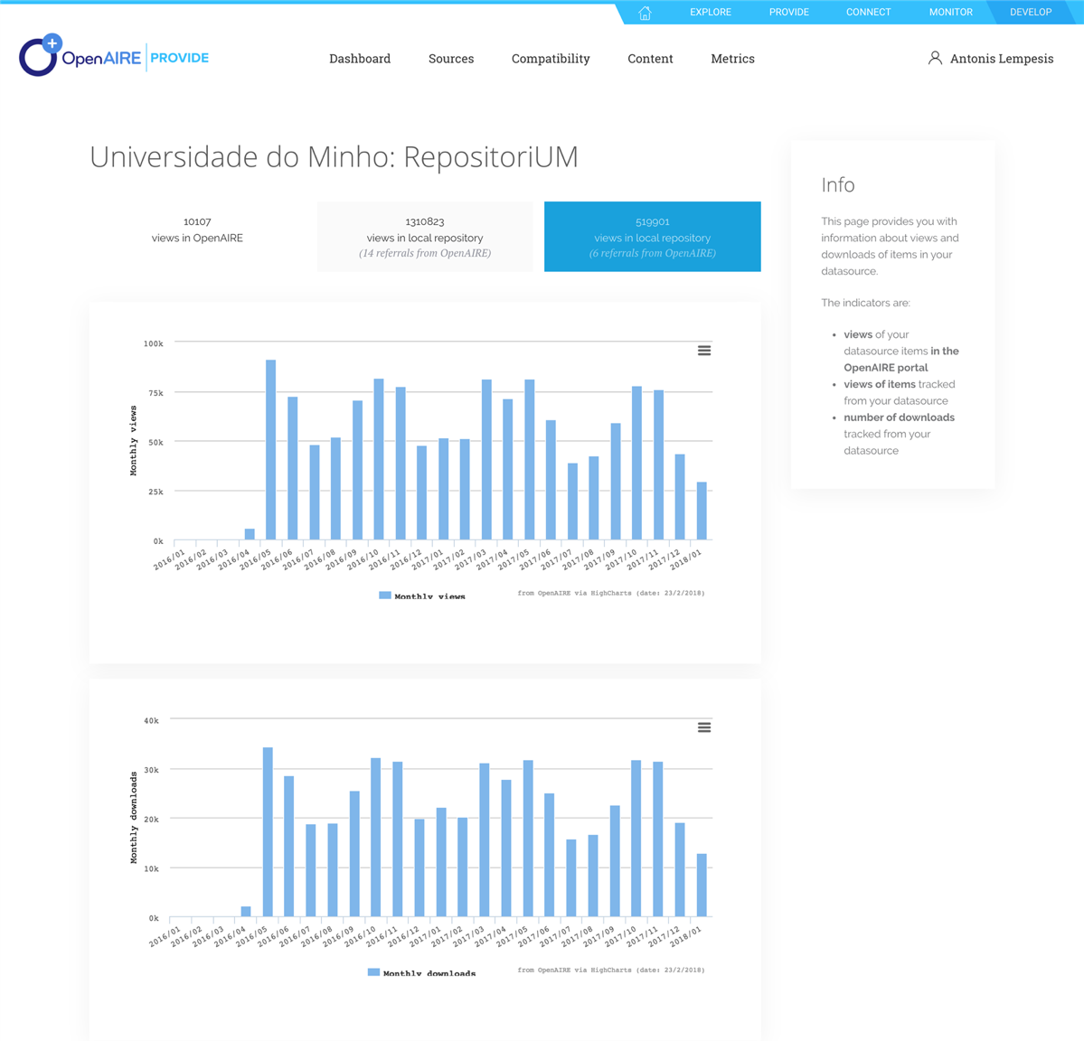
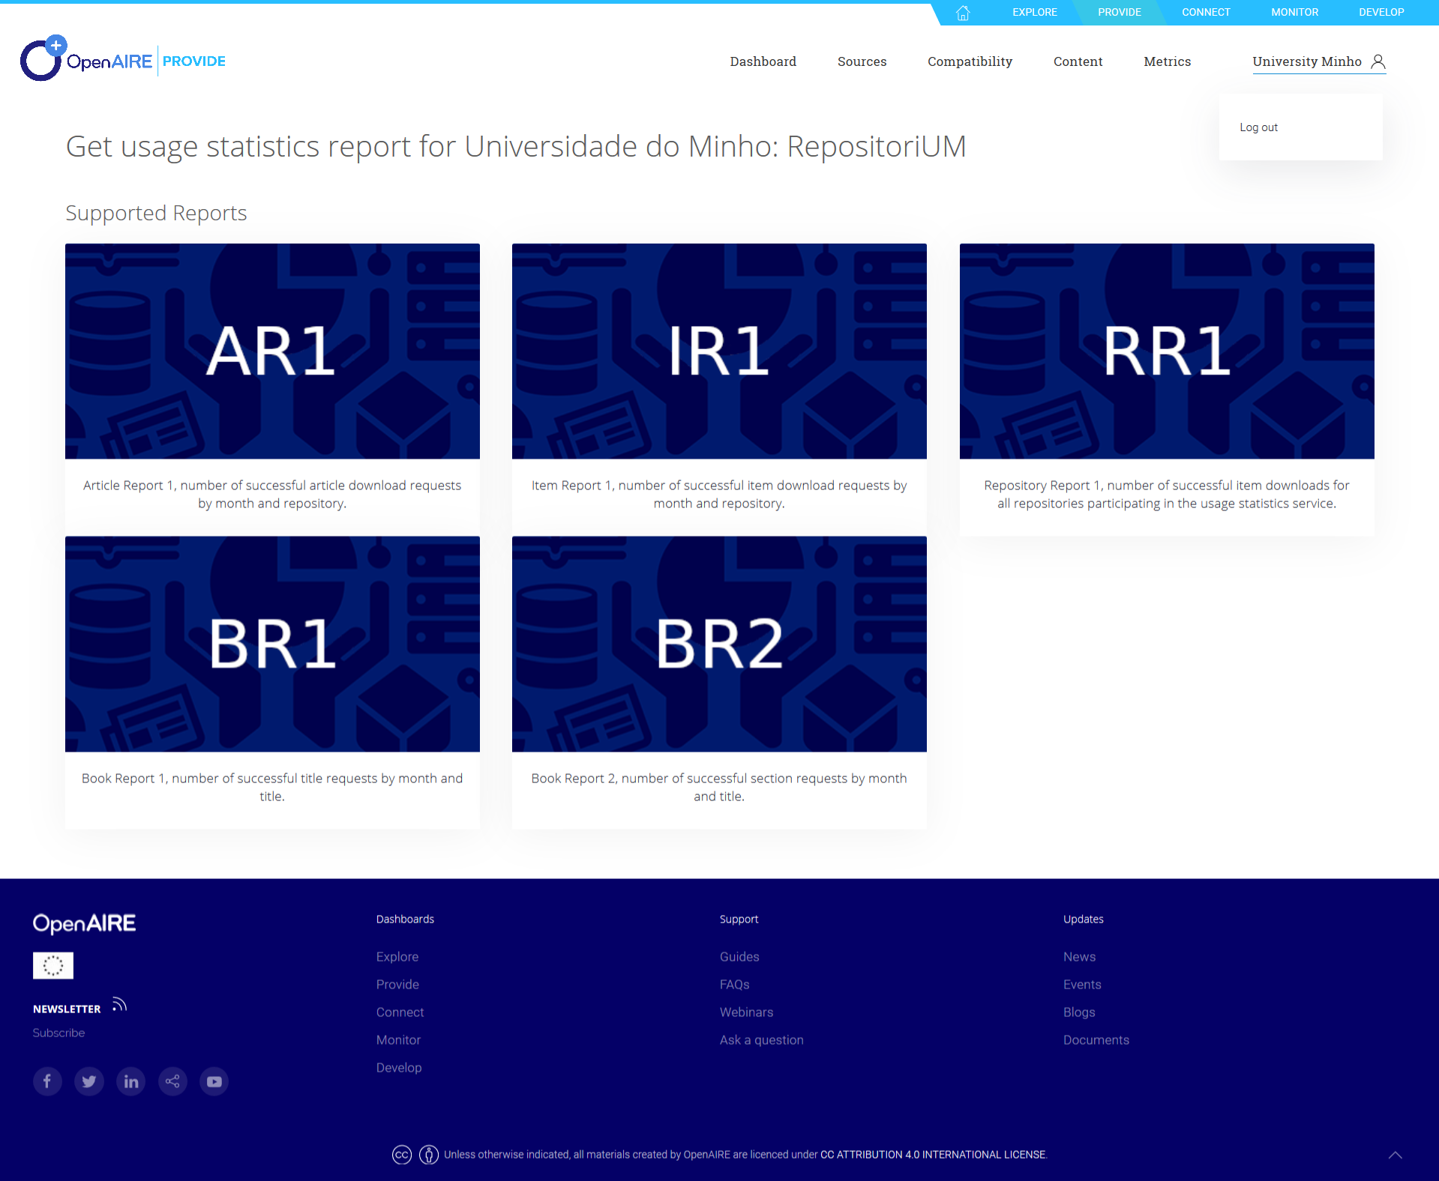
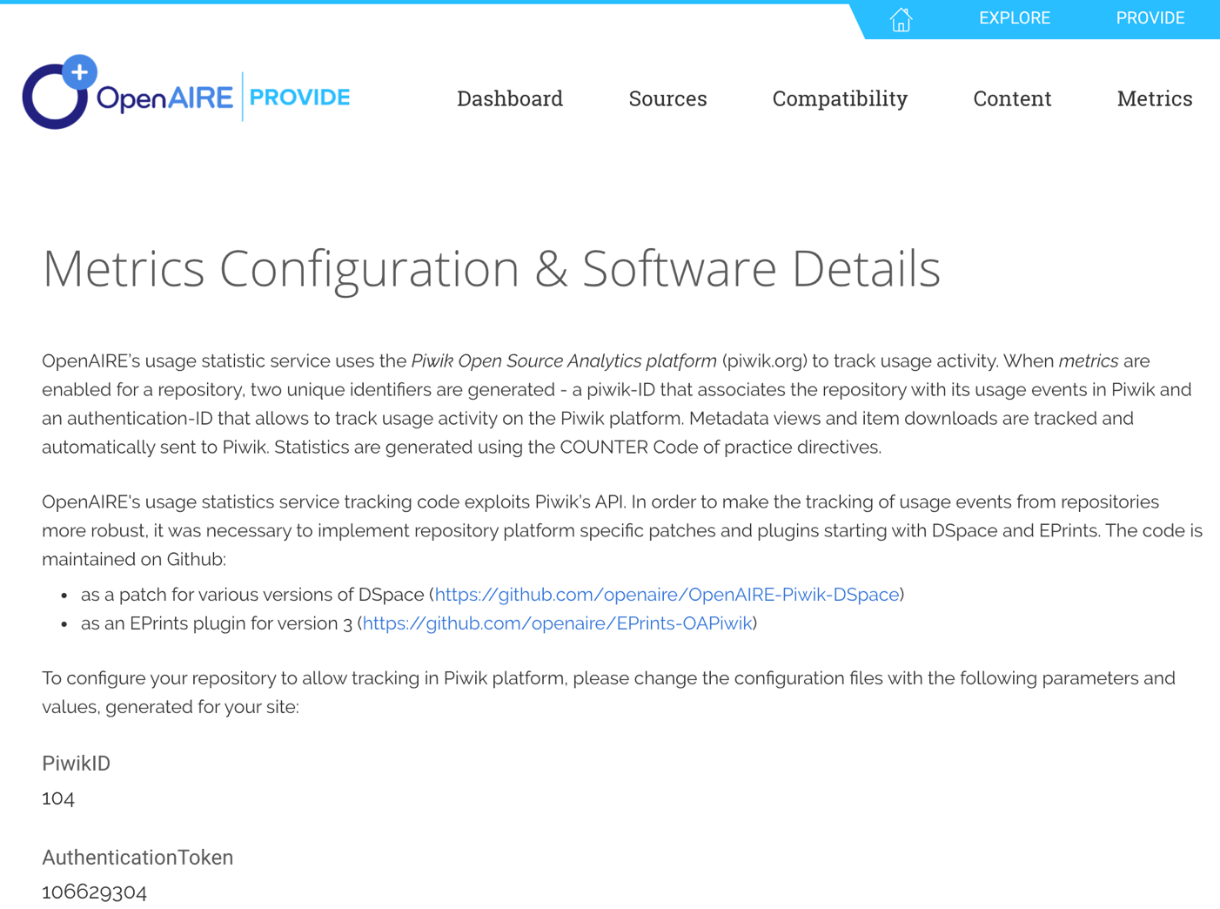
THE SERVICE COLLECTS AND EXPLOITS USAGE METRICS LIKE DOWNLOADS AND METADATA VIEWS (tracking plugin, SUSHI endpoint, COUNTER reports)

Slide 16

provide.openaire.eu
In production since October!

Slide 17




OpenAIRE’s e-infrastructure Commons – BROKER CONCEPT
TERMS
OF USE
Repositories in OpenAIRE may be interested to acquire metadata information about publications that are
“potentially of interest to them”
i.e. be part of their collection: add new records, enrich the records with extra metadata information.
INFO SPACE SERVICES
Funding
Funder
Cleaning
De-duplication
Organization
Project
initiative
Validation
Enrichment
By inference
Result
Publication
Data
Software
GUIDE
LINES
CONTENT PROVIDERS
Publications repositories
Research Data repositories
CRIS
systems
Registries
(e.g. projects)
OA
Journals
Software
Repositories

Slide 18

OpenAIRE Broker sketch
Event (potential notification):
Message
Topic
TargetRepository
Trust
Identifying “events” relevant to repositories
(enrichments & additions)
OpenAIRE
Notification Broker
OpenAIRE Information Space Graph
(deduplication,
Inference,
Aggregation)
subscribe
Sending events
repository admin
notify
Subscriptions
Potential
Notifications
…
Delivered
Notifications
OpenAIRE Data Sources
18

Slide 19
Enrichments events from the broker service
ENRICH/MISSING/PROJECT - OpenAIRE discovered references to research projects that can be associated to your publications
ENRICH/MISSING/OPENACCESS_VERSION - OpenAIRE discovered Open Access versions of your publications
ENRICH/MISSING/PID - OpenAIRE discovered missing persistent identifiers associated to your publications
ENRICH/MISSING/ABSTRACT - OpenAIRE discovered missing abstracts among your publications
ENRICH/MISSING/DATE - OpenAIRE discovered missing date values to your publications
ENRICH/MISSING/SUBJECT/MESHEUROPMC - OpenAIRE discovered classification terms from the Medical Subject Headings that can be associated to your publications
ENRICH/MISSING/SUBJECT/JEL - OpenAIRE discovered Journal of Economic Literature (JEL) classification terms that can be associated to your publications
ENRICH/MISSING/SUBJECT/DDC - OpenAIRE discovered Dewey Decimal classification terms (DDC) that can be associated to your publications
ENRICH/MISSING/SUBJECT/ACM - OpenAIRE discovered ACM classification terms that can be associated to your publications
ENRICH/MISSING/SUBJECT/ARXIV - OpenAIRE discovered ARXIV classification terms that can be associated to your publications

Slide 20
Enrichments:
MORE metadata
or
MISSING metadata

Slide 21

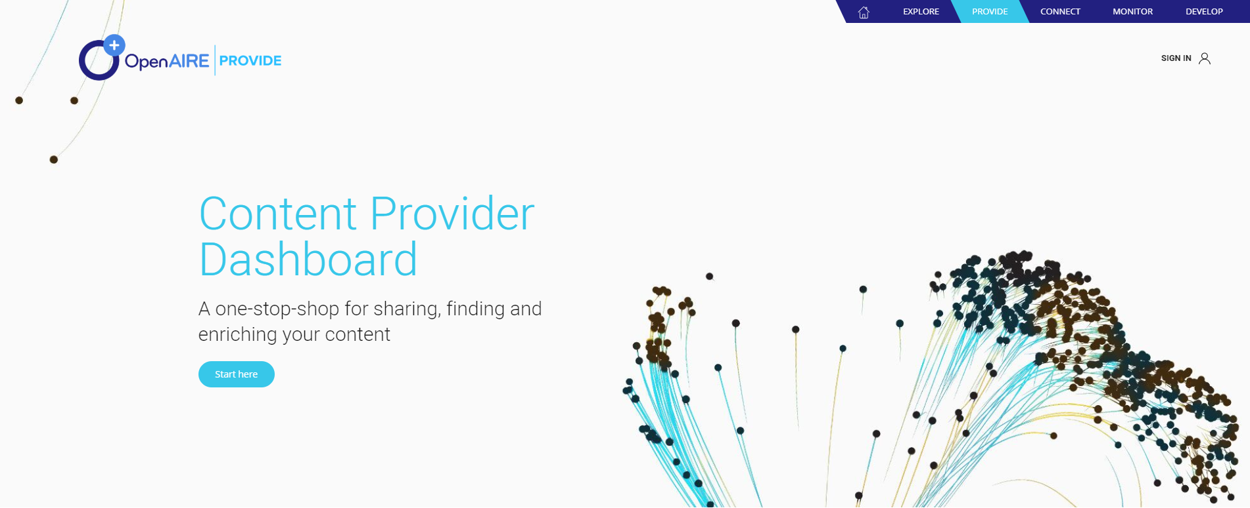
provide.openaire.eu

Slide 22
Support materials for Content Providers Dashboard uptake
Support – guides
Training – webinars
Provide - How to validate and register your repository
Provide - How to enrich research artifacts
Usage Statistics – How to track the usage activity of your repository
ScholExplorer - Literature & Data interlinking
Making your repository Open
Make your content count - OpenAIRE Content providers Dashboard: service for repository managers
OpenAIRE metrics service: usage statistics
OpenAIRE Guidelines for data providers: new Metadata Application Profile for Literature Repositories

Slide 23
OpenAIRE Content Provider Dashboard
what comes next

Slide 24
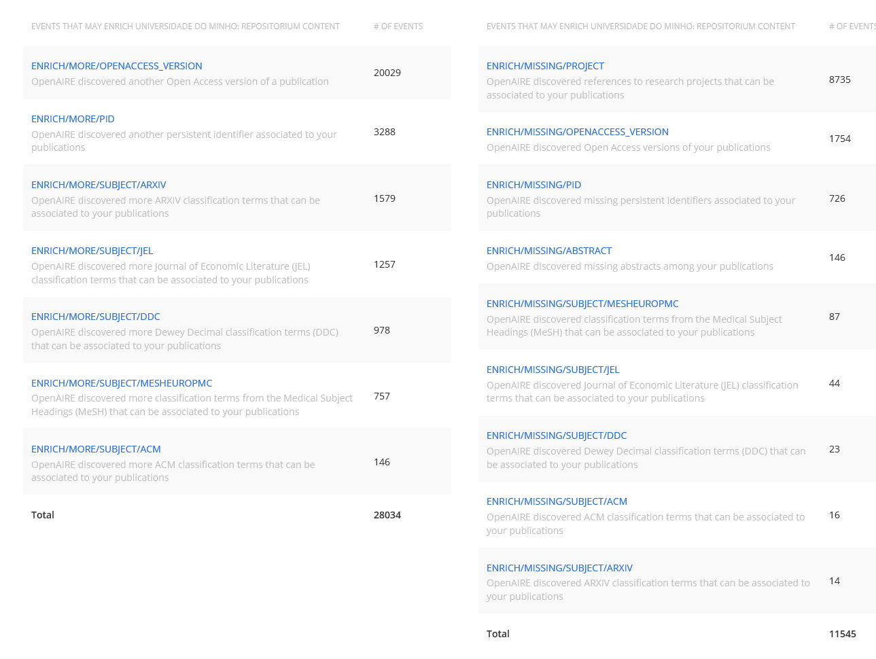
New broker events
ORCID > Publications/Datsets/software
Datasets > Projects
Publications <-> Software
Publications <-> Datasets

Slide 25
OpenAIRE usage statistics service
Overview, demo and collection workflows

Slide 26
Why Usage Statistics
Authors / readers: to assess impact and to compare with scholarly works of peers
Repository managers: how often / how well is the repository service used
Research funders / administrators: usage metrics as part of a variety of metrics to assess impact of research funded or supported
Open research impact empowers Open Science

Slide 27
How it works
(1) Tracking of usage events or (2) retrieving COUNTER reports on scholarly work items in repositories
Applying rules based on COUNTER CoP
Aggregating metrics on usage for scholarly works
Repository plugins to track usage events

Slide 28


TIERS Collection Workflows for Usage Statistics
Repository
CRIS
eJournal
National Statistics Node
Publisher
IP-Anonym.
PUSH
tracked event
PULL
COUNTER Report
Metadata-Index
processing script
UsageStatistics-DB
processing script
Notes:
diagram about the components and dataflow
usage data collection strategies

Slide 29
Matomo Tracking Parameters
TIER-1
Parameter | Description
idSite | the ID of the repository
idVisit | a visitor/session ID (an 8 byte binary string)
visitIP (optionally anonymized) | the IP address of the visitor
action | the action performed (view, download, outlink, etc)
url | the url of the requested item
timestamp | the date & time of the request
OAI-PMH Identifier | the Open Access Initiative identifier of the item being viewed/downloaded
agent | the Web Browser and the operating system of the visitor
referrer | The url linked to the item requested

Slide 30

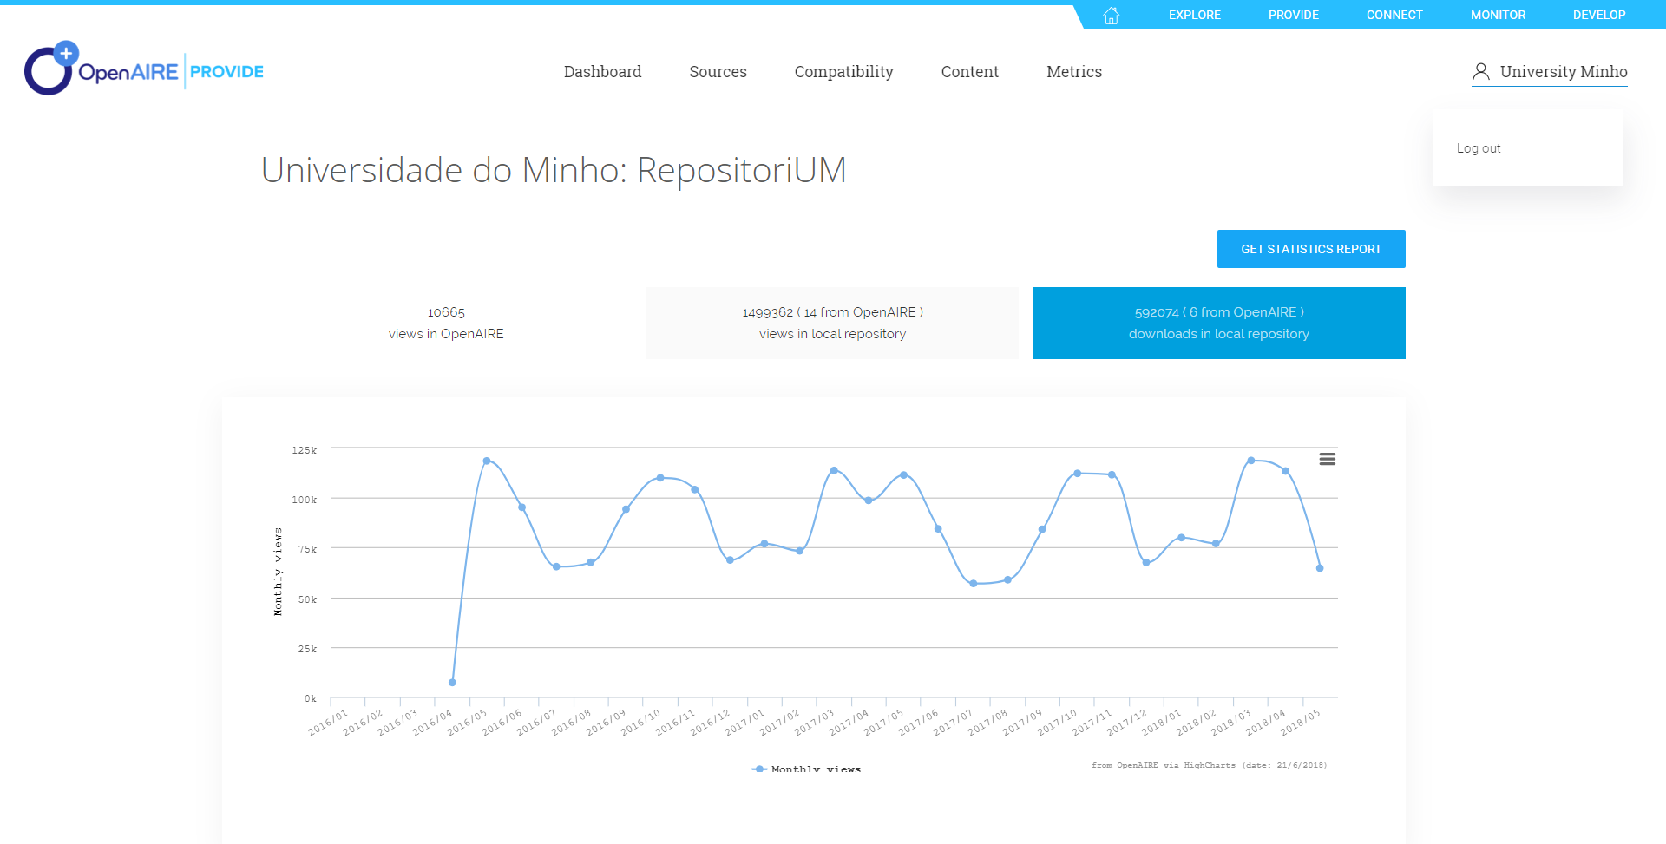
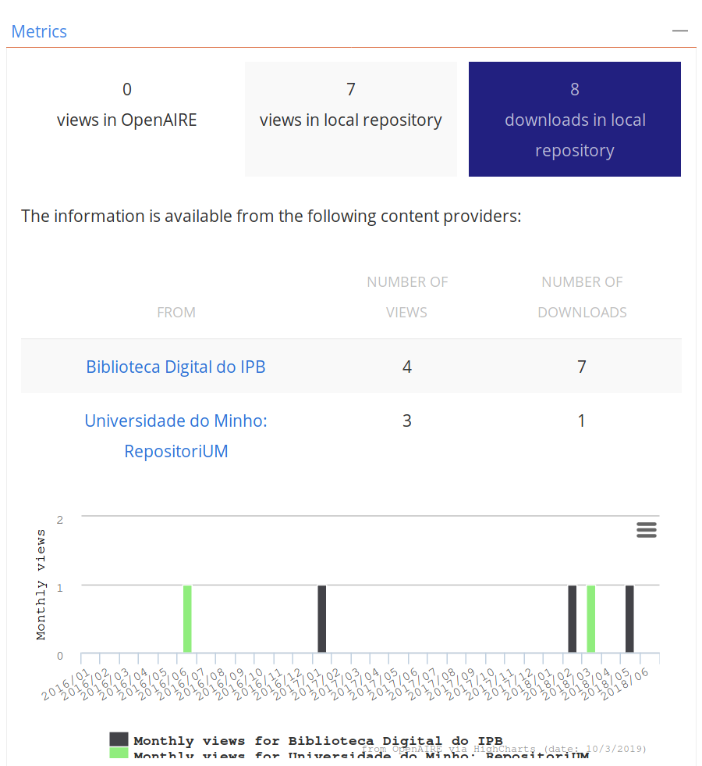
Usage Statistics on Datasource and Item Level

Slide 31
OpenAIRE Exposes Usage Statistics
http://services.openaire.eu/usagestats/sushilite/
COUNTER compliant usage statistics reports for Repositories

Slide 32

Main Challenges and Limitations
Comparability of Usage Statistics across platforms
  Must be collected and processed by agreed common standards, e.g. COUNTER CoP
  Must be openly accessible by default (e.g. CC-0 license)
Comparability of Usage Statistics of different versions of an item
  e.g. Usage Statistics of Open Access vs. non-Open Access item versions
  Usage Statistics must be enriched by item identifiers
  Items must have comprehensive metadata descriptions
Contextualized Usage Statistics
  COUNTER Reports are a basic first step but limited on statistics per platform (items)
  Aggregated usage statistics of deduplicated items
  Linked research results and their Usage Statistics in the context of
    (e.g. a project or topic)

Slide 33
Architecture and Workflows for Usage Statistics
Repository
CRIS
eJournal
National Statistics Node
Publisher
IP-Anonym.
PUSH
tracked event
PULL
COUNTER Report
Metadata-Index
processing script
UsageStatistics-DB
processing script
Notes:
diagram about the components and dataflow
usage data collection strategies

Slide 34
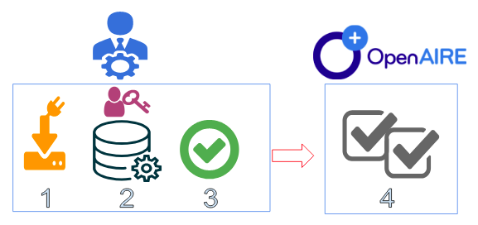
Metrics in the OpenAIRE Dashboard for content providers
Four steps to join OpenAIRE Usage Statistics
Download.
Configure.
Deploy.
Validate (by OpenAIRE).
Or enter SUSHI endpoint to let OpenAIRE collect COUNTER reports

Slide 35
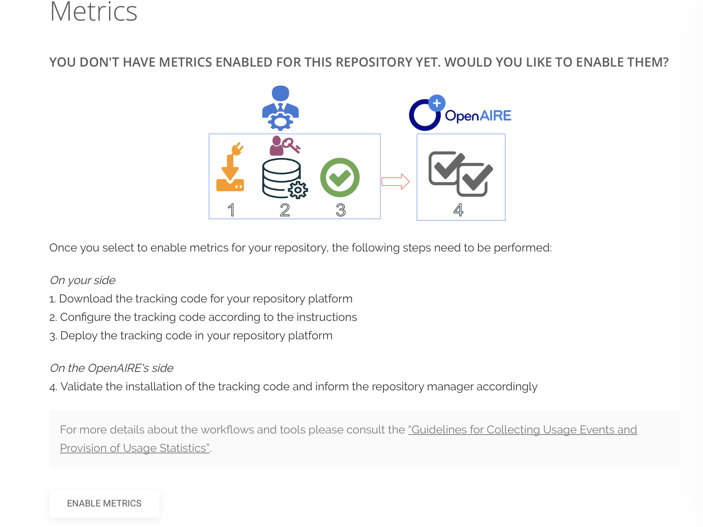
Enable Metrics for selected Datasource

Slide 36
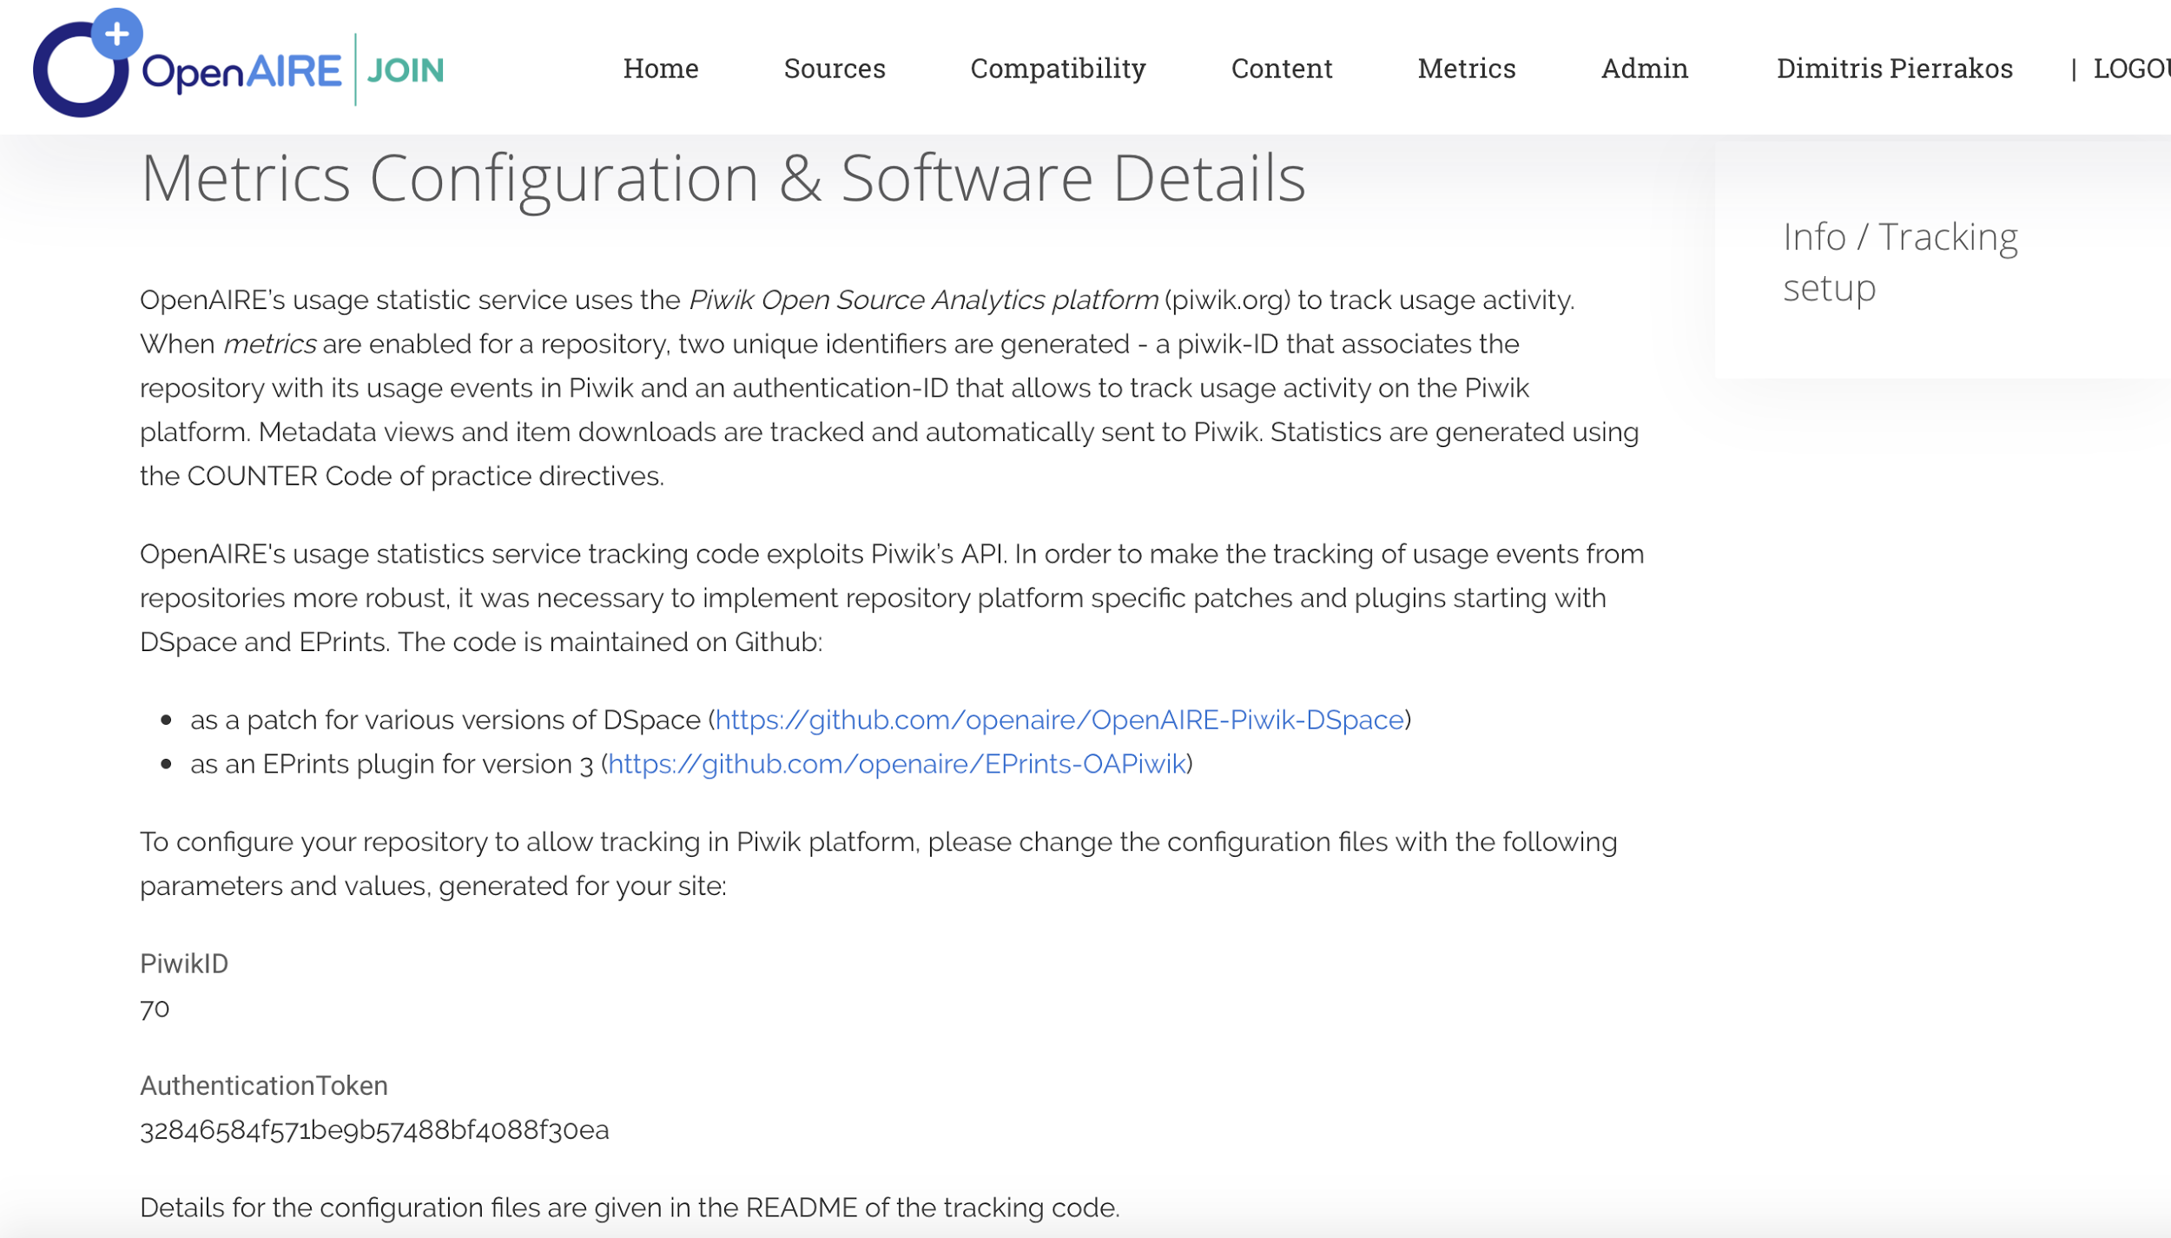
Configure Metrics for selected Datasource
000
01233456

Slide 37
Matomo Live tracking (Pull)
Demo Site:
http://demo.librecat.org/
Real time tracking:
https://analytics.openaire.eu/index.php?module=CoreHome&action=index&idSite=1&period=day&date=yesterday&updated=1#?idSite=1&period=day&date=yesterday&category=Dashboard_Dashboard&subcategory=1&popover=

Slide 38
Matomo offline collection of
COUNTER Reports (Push)
Irus-UK (aggregator) endpoint via SUSHI-Lite:
https://irus.jisc.ac.uk/api/sushilite/v1_7/Client/IR1/
Aberdeen University Research Archive (irusuk:28)
https://irus.jisc.ac.uk/api/sushilite/v1_7/GetReport/?Report=IR1&Release=4&RequestorID=Jisc&BeginDate=2019-01&EndDate=2019-03&RepositoryIdentifier=irusuk%3A28&ItemIdentifier=&ItemDataType=&hasDOI=&Granularity=Monthly&Callback=&Pretty=Pretty

Slide 39
Usage Statistics Reports
Repository Statistics from the Content Providers Dashboard
provide.openaire.eu
COUNTER reports using the SushiLite API
http://services.openaire.eu/usagestats/sushilite/
http://services.openaire.eu/usagestats/sushilite/GetReport/?Report=IR1&Release=4&RequestorID=anonymous&BeginDate=2019-01&EndDate=2019-02&RepositoryIdentifier=opendoar%3A1714&ItemIdentifier=&ItemDataType=&Granularity=Monthly&Pretty=Pretty

Slide 40

www.openaire.eu
@openaire_eu
facebook.com/groups/openaire
pedroprincipe@sdum.uminho.pt

