Slide 1
Becoming compliant to the Scholix framework
Alessia Bardi
Institute of Information Science and Technologies National Research Council, Italy

Slide 2
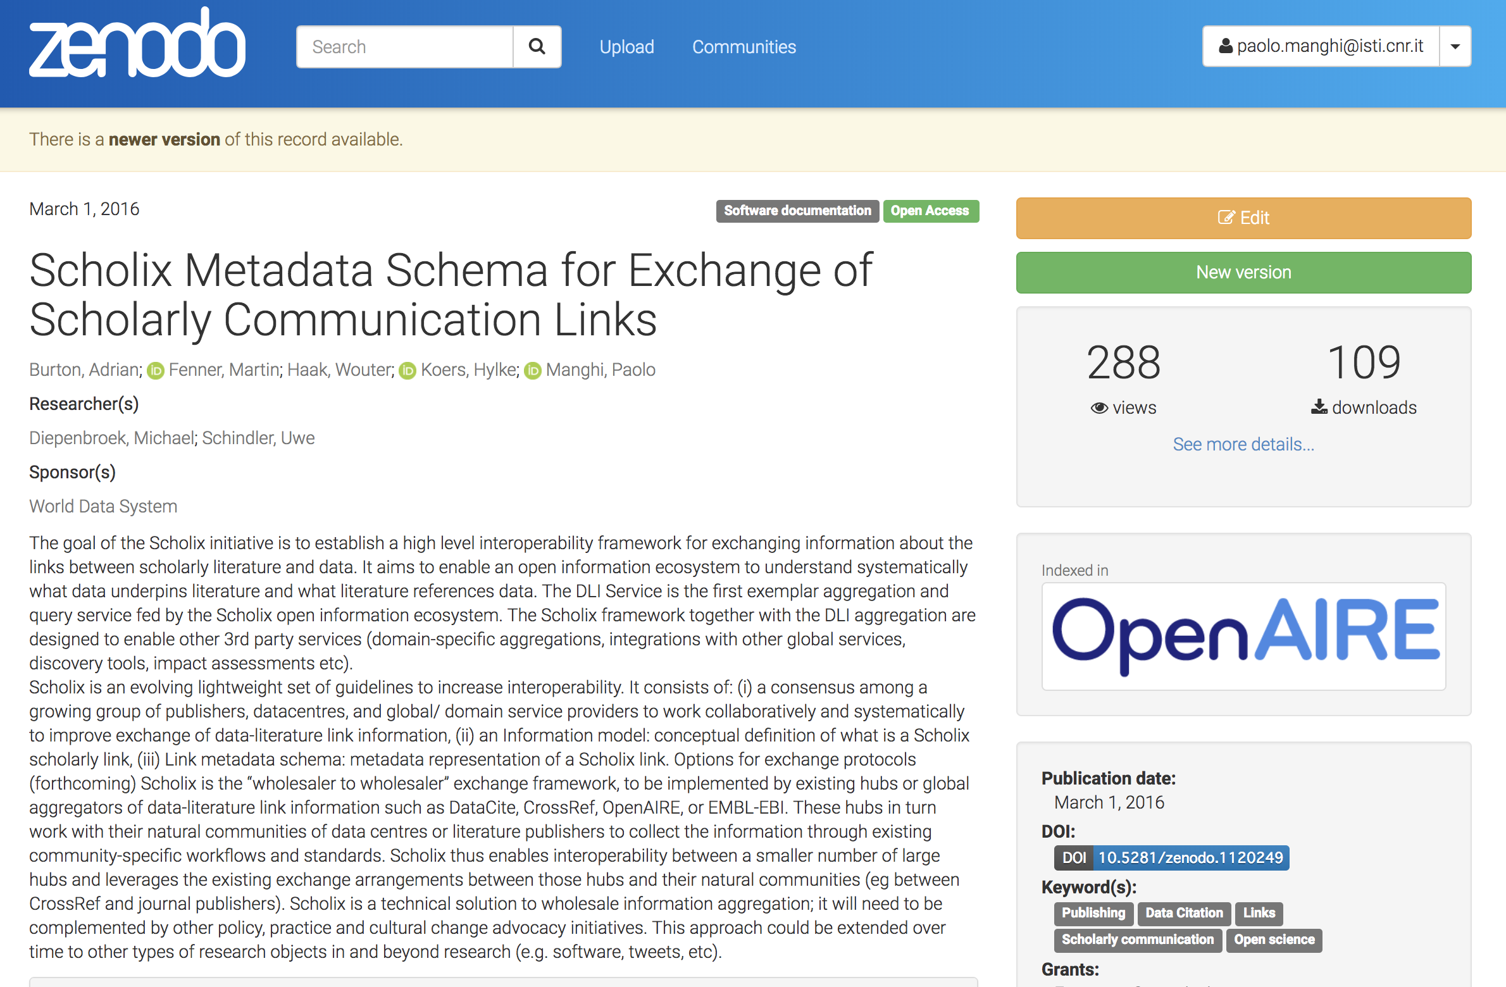
RDA/WDS Working Group
A framework for standardizing the exchange of scholarly link information between scholarly infrastructure providers
Information Model for scholarly links representation
Recommendation and provision of exchange formats (JSON/XML-based)

Slide 3
Scholix: multi-hub interoperability framework
Hubs are (existing) services that collect and aggregate information about links from their respective communities
Each journal, data center, repository must interoperate with only one hub to get information from all the hubs.
Notes:
Hubs are (existing) services that collect and aggregate information about links from their respective communities
The multi-hub network is interoperable among the
hubs and thus facilitates interoperability among
data centers, journal publishers, repositories, etc.
via the hubs. Interoperability among the hubs
is achieved by hub-commitment to the common
information model and open exchange methods
described earlier. A high level of conformity and
uniformity is assumed in the information exchanged
between the hubs.
However, the hubs do not affect existing
community-specific practices. There is no
requirement for "many to many" interoperability
between data centres, journals and repositories.
In contrast to the uniformity among the hubs,
heterogeneity is a natural part of the outer layer and is addressed by the hubs with their communities.

Slide 4
Two options
1. Provide links to a hub
If you are an OpenAIRE compliant repository your links are already in ScholeXplorer
For faster synchronization, you can be harvested directly by ScholeXplorer
2. Become a hub
Ask for approval from the Scholix supporters
Expose your links using the Scholix schema
Become interoperable with the other hubs
Register in the list of Scholix hubs
Suggeted route for institutional repositories (via OpenAIRE/ScholeXplorer), journals (via CrossRef), and Datacite (data centers)
Suggeted route for a data source that does not fall in the other three categories

Slide 5
Provide links to ScholeXplorer
ScholeXplorer collects records in different formats and extracts the links: datacite, JATS (+ other idiosyncratic formats for datasets, like ENA)
ScholeXplorer can collect records via OAI-PMH, REST API, (S)FTP, etc.
You do not need to export links according to the Scholix schema, but you should provide all the information needed by ScholeXplorer to re-expose the links in Scholix format.
Any missing metadata information? ScholeXplorer does its best to resolve the linked PIDs and get the missing info
Register to OpenAIRE and everything will come for free

Slide 6
Questions?

