Slide 1
The Scholix framework and ScholeXplorer
Alessia Bardi
Institute of Information Science and Technologies
National Research Council, Italy

Slide 2





eResearch Africa - Workshop on Research data systems – help or hindrance in data sharing? – 16 Apr, 2019

Slide 3
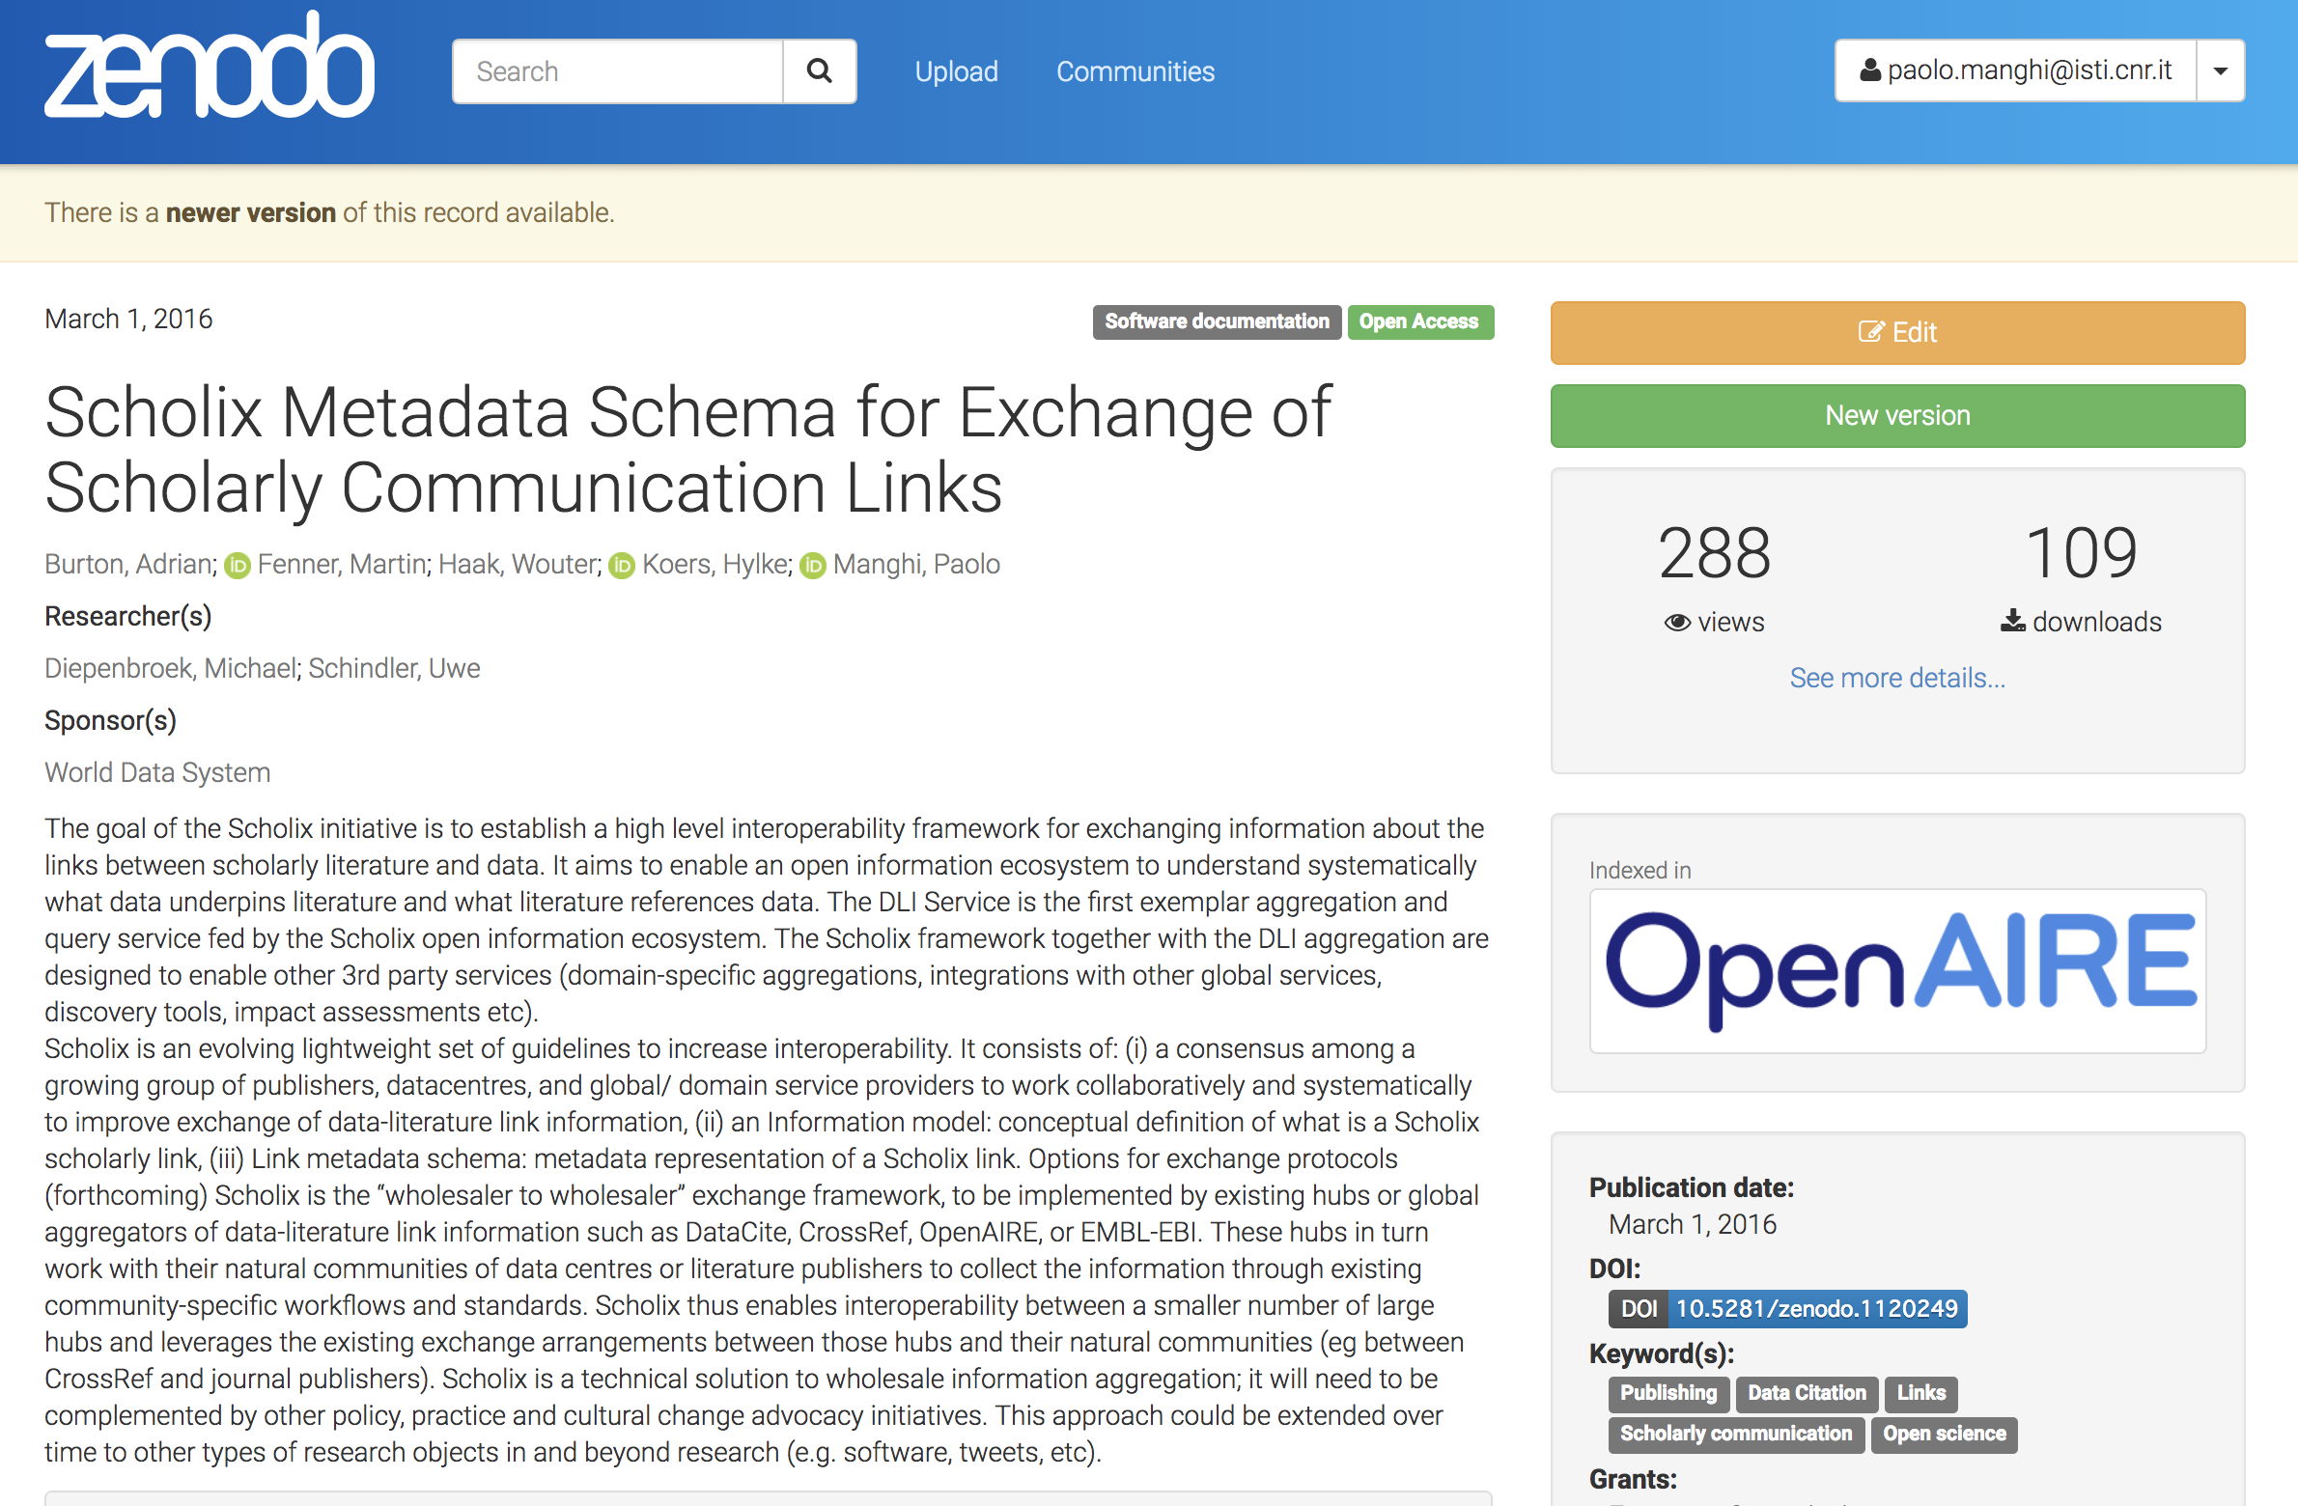
RDA/WDS Working Group
        A framework for standardizing the exchange of scholarly link information between scholarly infrastructure providers
          Information Model for scholarly links representation
          Recommendation and provision of exchange formats (JSON/XML-based)
eResearch Africa - Workshop on Research data systems – help or hindrance in data sharing? – 16 Apr, 2019

Slide 4
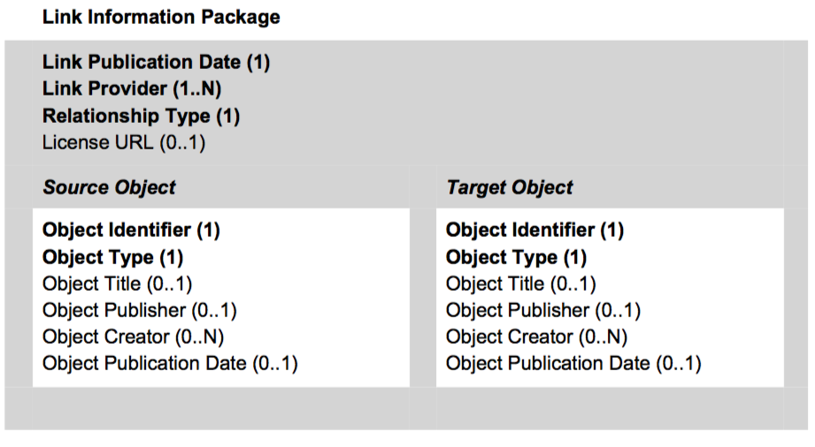

Scholix data model: from the moon
eResearch Africa - Workshop on Research data systems – help or hindrance in data sharing? – 16 Apr, 2019

Slide 5
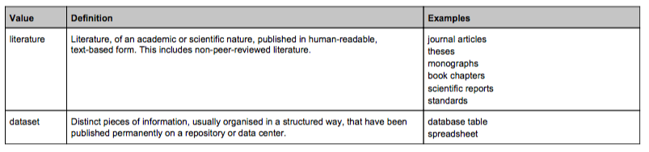
Scholix: Object Types
eResearch Africa - Workshop on Research data systems – help or hindrance in data sharing? – 16 Apr, 2019

Slide 6
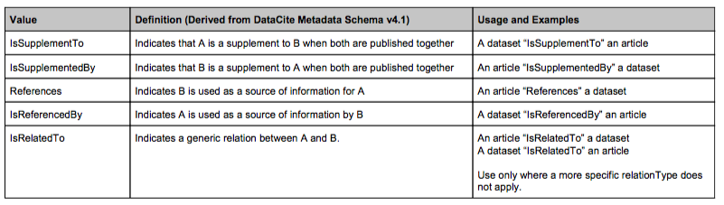
Scholix: Relationship types
eResearch Africa - Workshop on Research data systems – help or hindrance in data sharing? – 16 Apr, 2019

Slide 7
Scholix: multi-hub interoperability framework
Hubs are (existing) services that collect and aggregate information about links from their respective communities
Each journal, data center, repository must interoperate with only one hub to get information from all the hubs.
Notes:
Hubs are (existing) services that collect and aggregate information about links from their respective communities
The multi-hub network is interoperable among the
hubs and thus facilitates interoperability among
data centers, journal publishers, repositories, etc.
via the hubs. Interoperability among the hubs
is achieved by hub-commitment to the common
information model and open exchange methods
described earlier. A high level of conformity and
uniformity is assumed in the information exchanged
between the hubs.
However, the hubs do not affect existing
community-specific practices. There is no
requirement for "many to many" interoperability
between data centres, journals and repositories.
In contrast to the uniformity among the hubs,
heterogeneity is a natural part of the outer layer and is addressed by the hubs with their communities.

Slide 8




Scholix in practice: the Hubs
Data repositories
prototype
https://www.datacite.org/eventdata.html
Via Datacite REST API -- events
Publishers
BETA
https://www.crossref.org/services/event-data
Via Query API
Institutional repositories
PRODUCTION
http://scholexplorer.openaire.eu/
Via Open API
eResearch Africa - Workshop on Research data systems – help or hindrance in data sharing? – 16 Apr, 2019

Slide 9

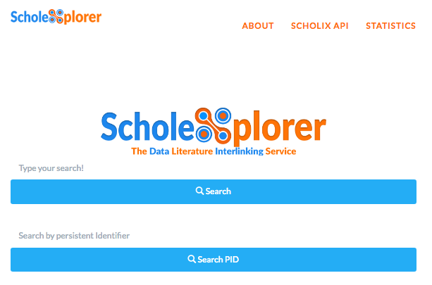
Scholexplorer: data-literature links aggregator
http://scholexplorer.openaire.eu
Provision
Deduplication
LINKS!
Deployment co-funded by RDA
Resolution
Harvesting
55+ Mi bidirectional literature-dataset and dataset-dataset links between 8+ Mi datasets,1.3Mi publications, and 2Mi unknown
OpenAIRE-Advance Review, January 2019

Slide 10


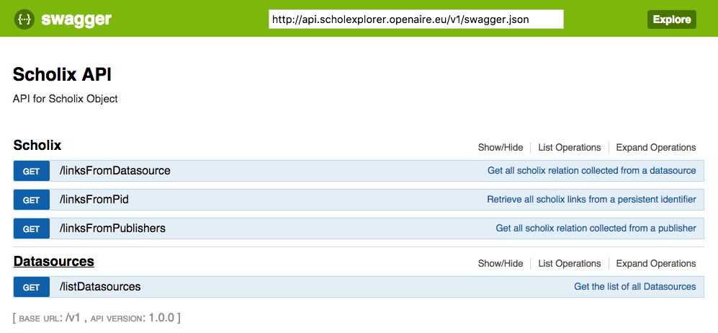









Use-cases: API and web portal
API: link search/resolution
WebUI: link discovery/navigation
140M requests per month
Avg response time 50ms
Harvesting of links
(every hour)
420+ Mi bi-directional links involving 50+ Mi datasets
API
Other sources
eResearch Africa - Workshop on Research data systems – help or hindrance in data sharing? – 16 Apr, 2019

Slide 11
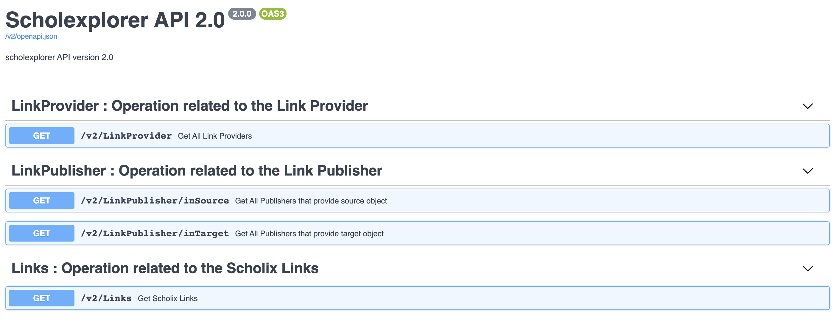
Scholexplorer APIs
http://api.scholexplorer.openaire.eu/v2/ui/

Slide 12
Try the API (1/4)
Go to http://api.scholexplorer.openaire.eu/v2/ui/
How many links are provided by Europe PMC?
  Use method /v2/LinkProvider with parameter:
    name: Europe PMC
How many links target datasets in ENA?
  Use method /v2/LinkPublisher/inTarget with parameter:
    name: European Nucleotide Archive

Slide 13
Try the API (2/4)
Get the links provided by Europe PMC that have an object with a DOI as target
  Use method /v2/Links with parameters:
    linkProvider: Europe PMC
    targetPidType: DOI
  Let’s check the reply together

Slide 14
Try the API (3/4)
Get the links provided by Datacite for objects published by Springer Nature
  Use method /v2/Links with parameters:
    linkProvider: Datasets in Datacite
    sourcePublisher: Springer Nature
Get the number of publications with links to datasets in Mendeley Data
  Use method /v2/Links with parameters:
    targetPublisher: Mendeley

Slide 15
Try the API (4/4)
Get the number of publications with links to datasets published in Mendeley
  Use method /v2/Links with parameters:
    targetPublisher: Mendeley
Now let’s see who published the source objects using jq:
curl -X GET "http://api.scholexplorer.openaire.eu/v2/Links?targetPublisher=Mendeley" -H "accept: application/json" | jq '.result[].source.Publisher[].name' | sort | uniq

Slide 16
Generate client for the ScholeXplorer API
https://swagger.io/docs/open-source-tools/swagger-codegen/
brew install swagger-codegen
swagger-codegen -h
swagger-codegen config-help -l <language name>
swagger-codegen generate -i http://api.scholexplorer.openaire.eu/v2/openapi.json -l <language_name>
<language_name>: e.g. java, python, csharp. Full list of supported languages:
  swagger-codegen langs

Slide 17
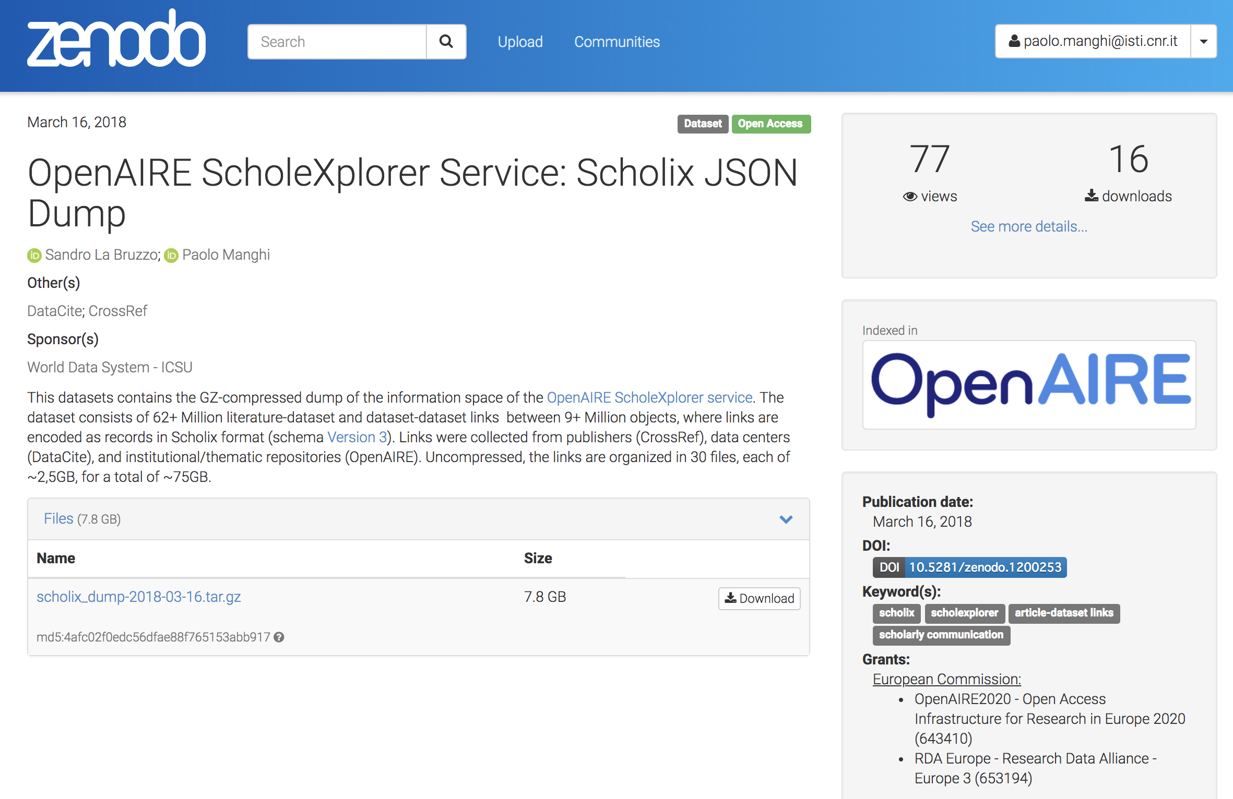


Use-cases: JSON dump
Datathons/
Hackatons
La Bruzzo, S. & Manghi, P. (2018). OpenAIRE ScholeXplorer Service: Scholix JSON Dump - March 2018 [Data set]. Zenodo. http://doi.org/10.5281/zenodo.1200253
eResearch Africa - Workshop on Research data systems – help or hindrance in data sharing? – 16 Apr, 2019

Slide 18
Using the API?
Tell us who you are and subscribe to the mailing list to receive news, ask for support and provide feedback
scholexplorer-help@openaire.eu

Slide 19
Alessia Bardi alessia.bardi@isti.cnr.it

