Slide 1
Scholarly Communication Services
Alessia Bardi
Institute of Information Science and Technologies
National Research Council, Italy

Slide 2



Why?
OpenDMP
Focus on interactions with platforms in order to maximize value, protect data ownership and portability, avoid vendor lock-in and do not re-invent the wheel

Slide 3
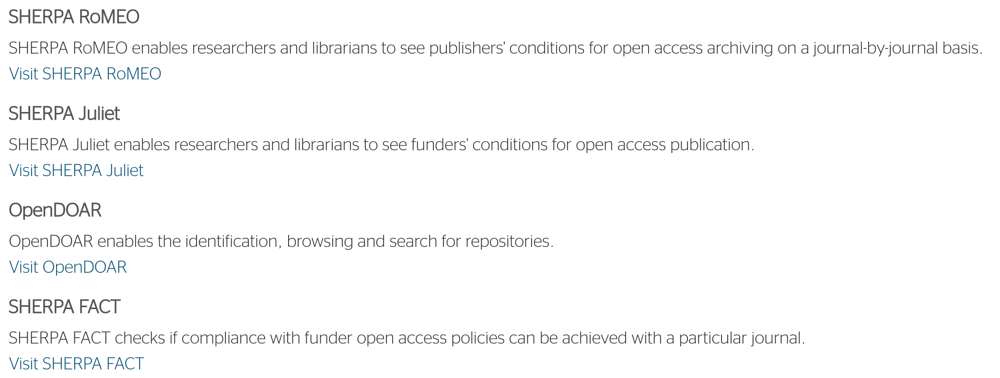
Publisher copyright policies & self-archiving
Funders' Open Access Policies
Global directory of Open Access repositories
Does this journal comply with that funder’s policy?

Slide 4
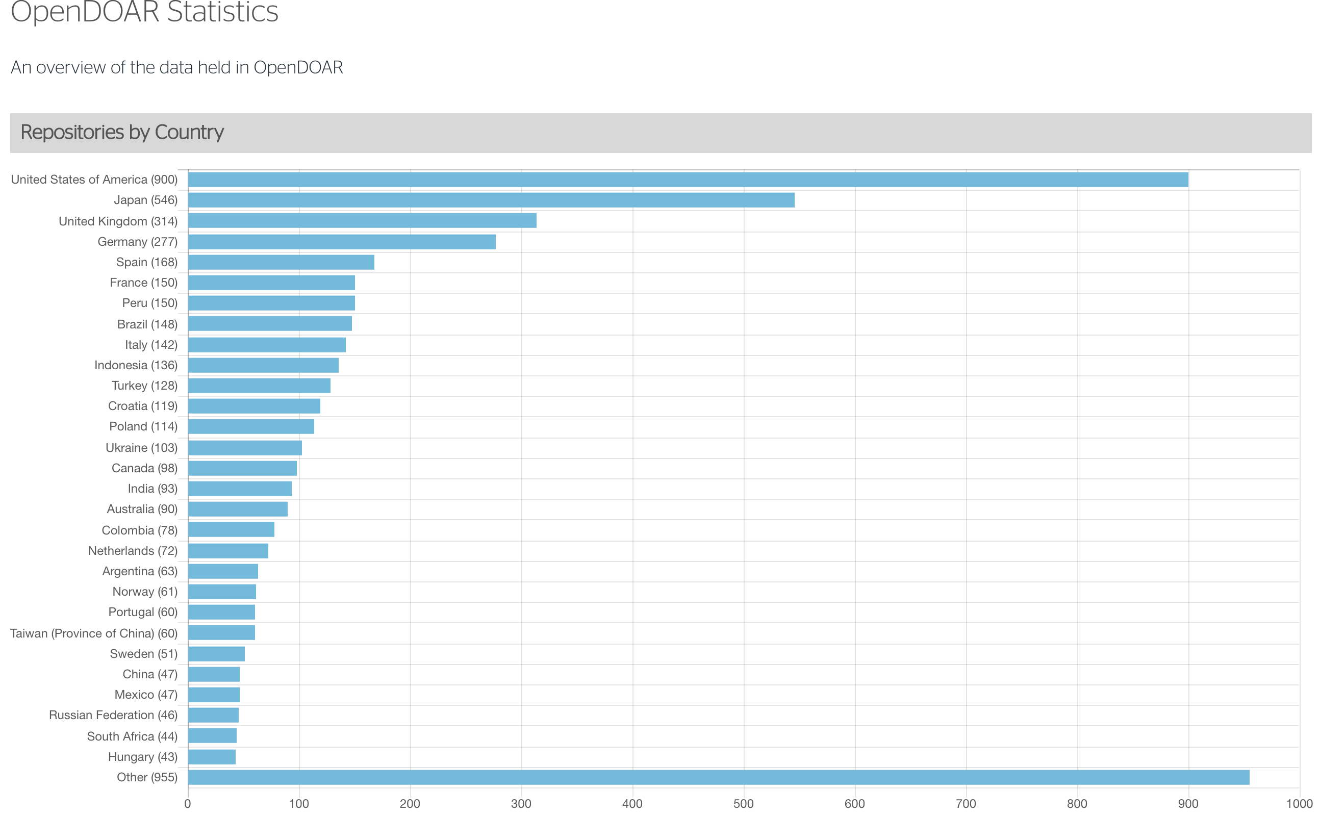
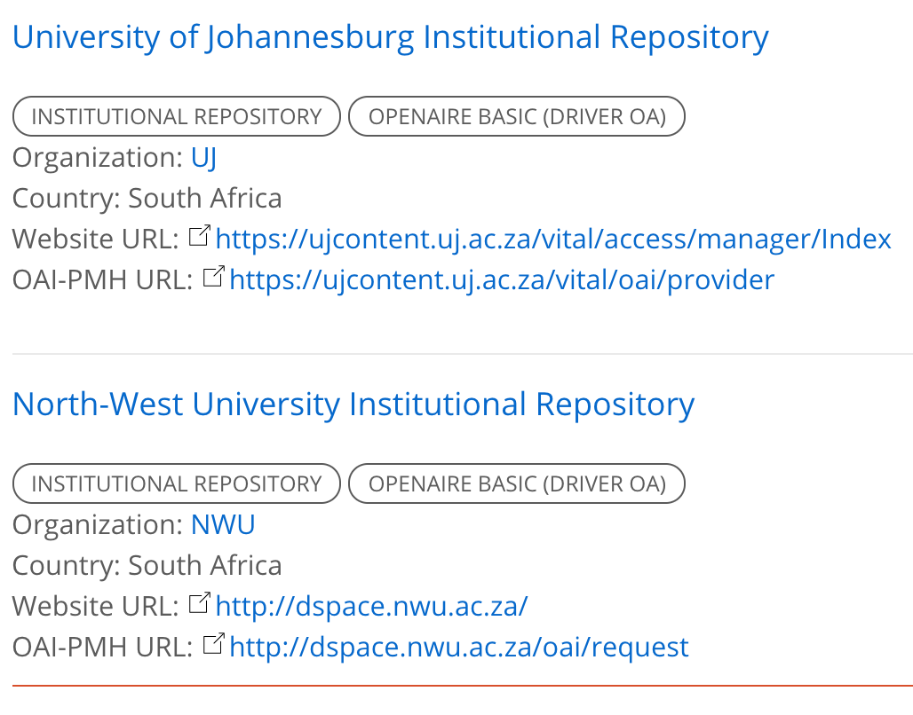
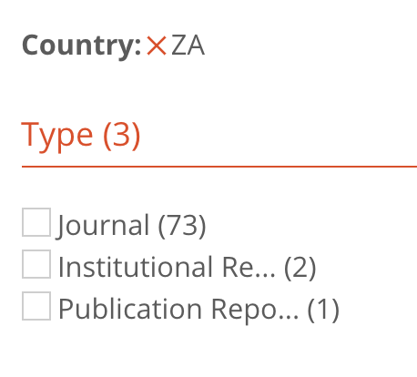
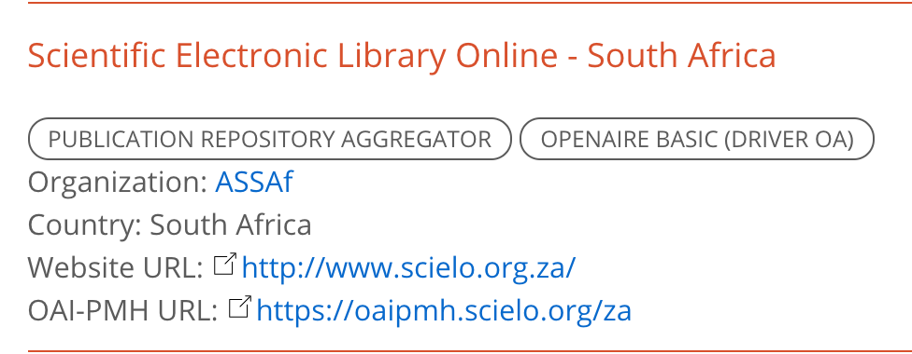

Slide 5
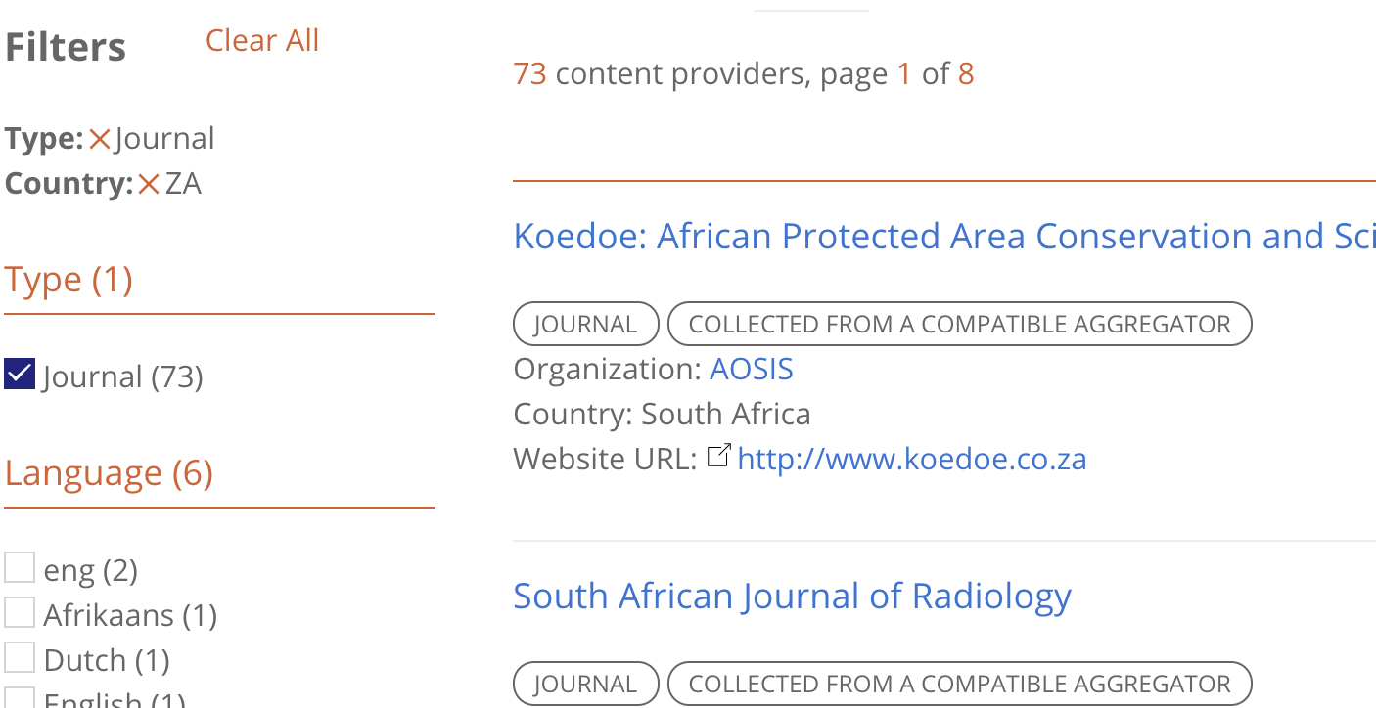
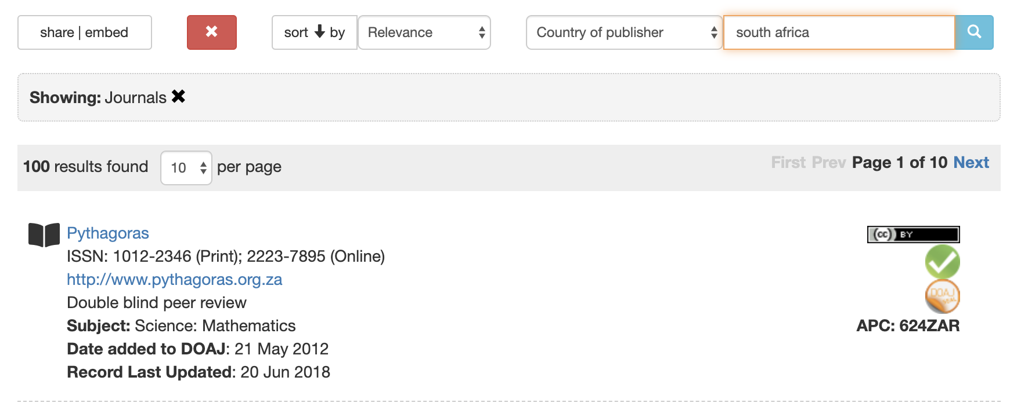

Slide 6
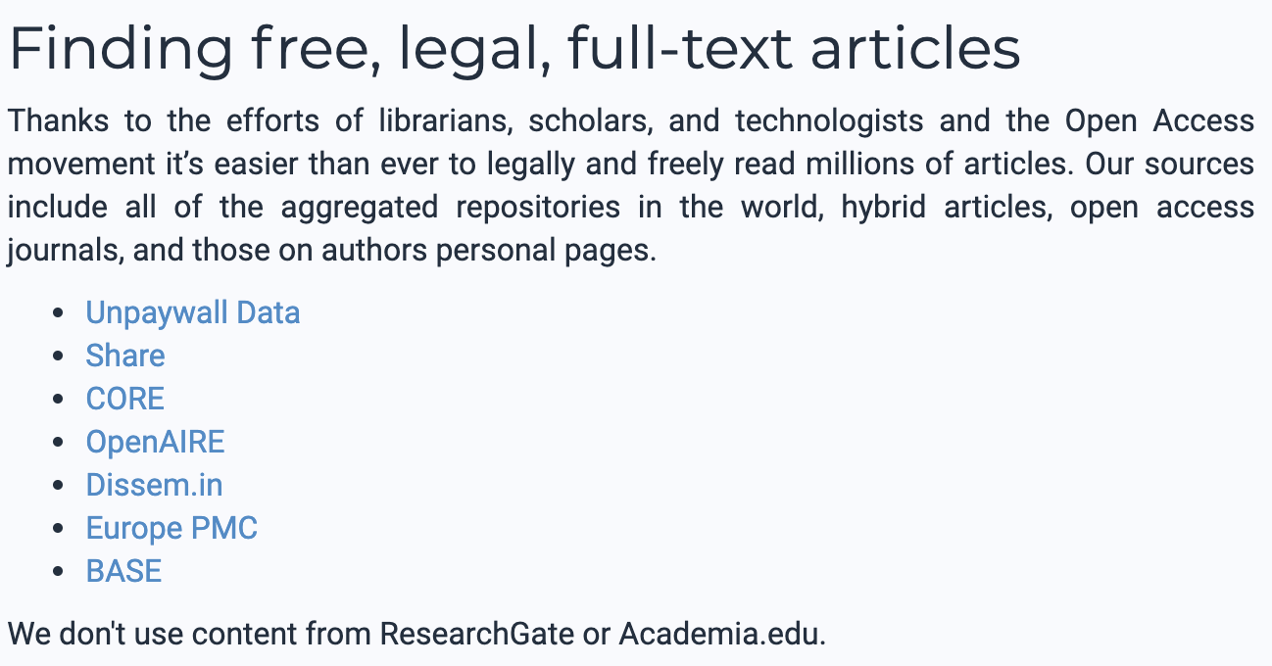
Open Access Button

Slide 7
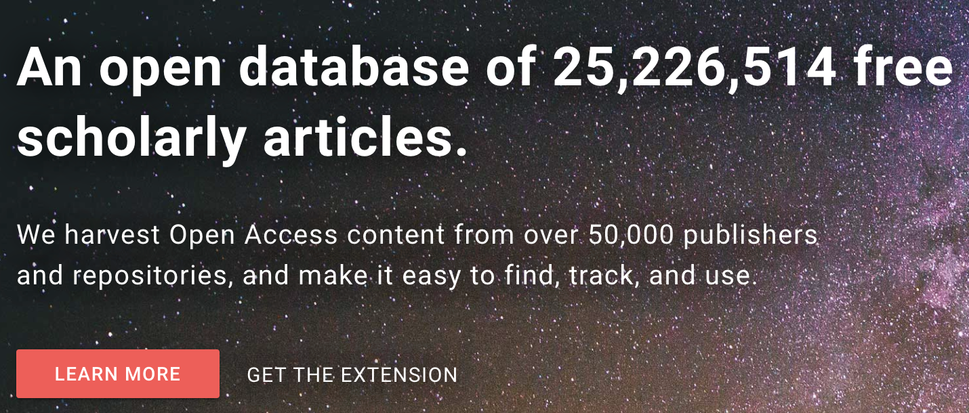

Slide 8
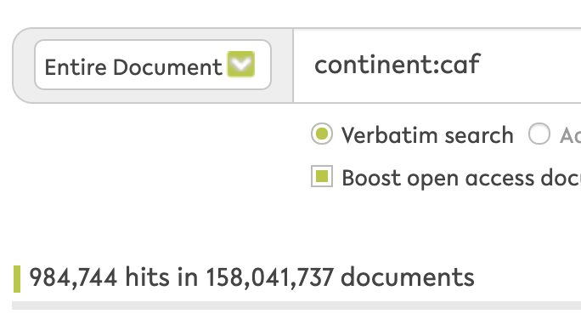

Slide 9
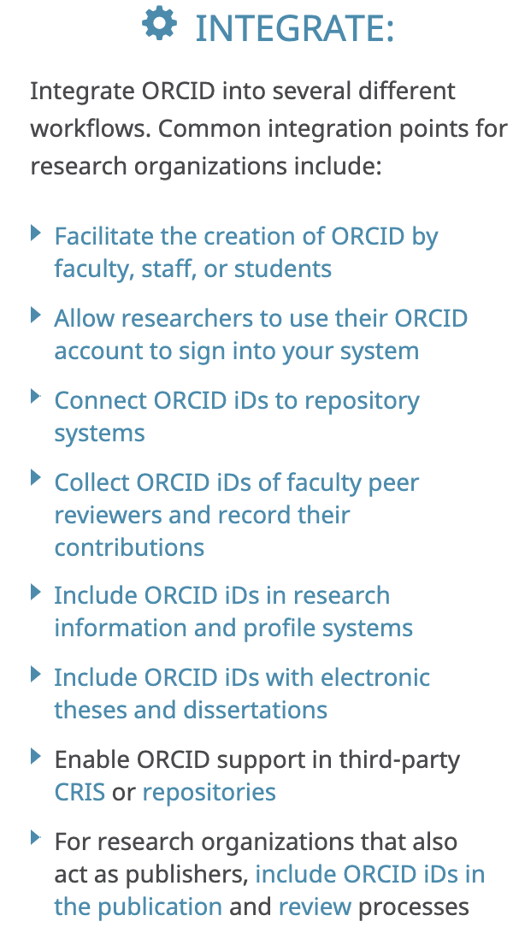
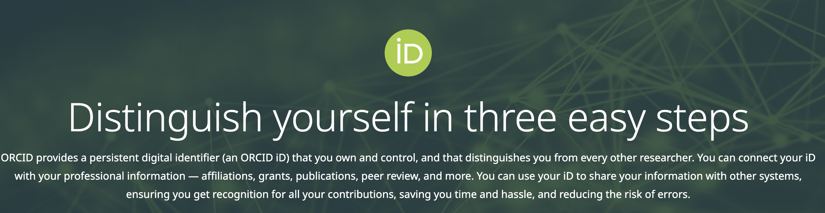

Slide 10
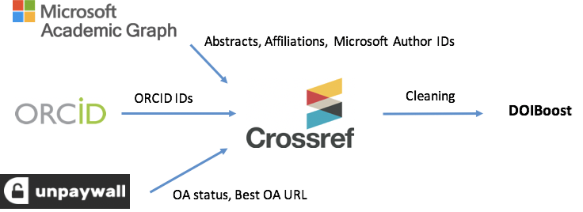
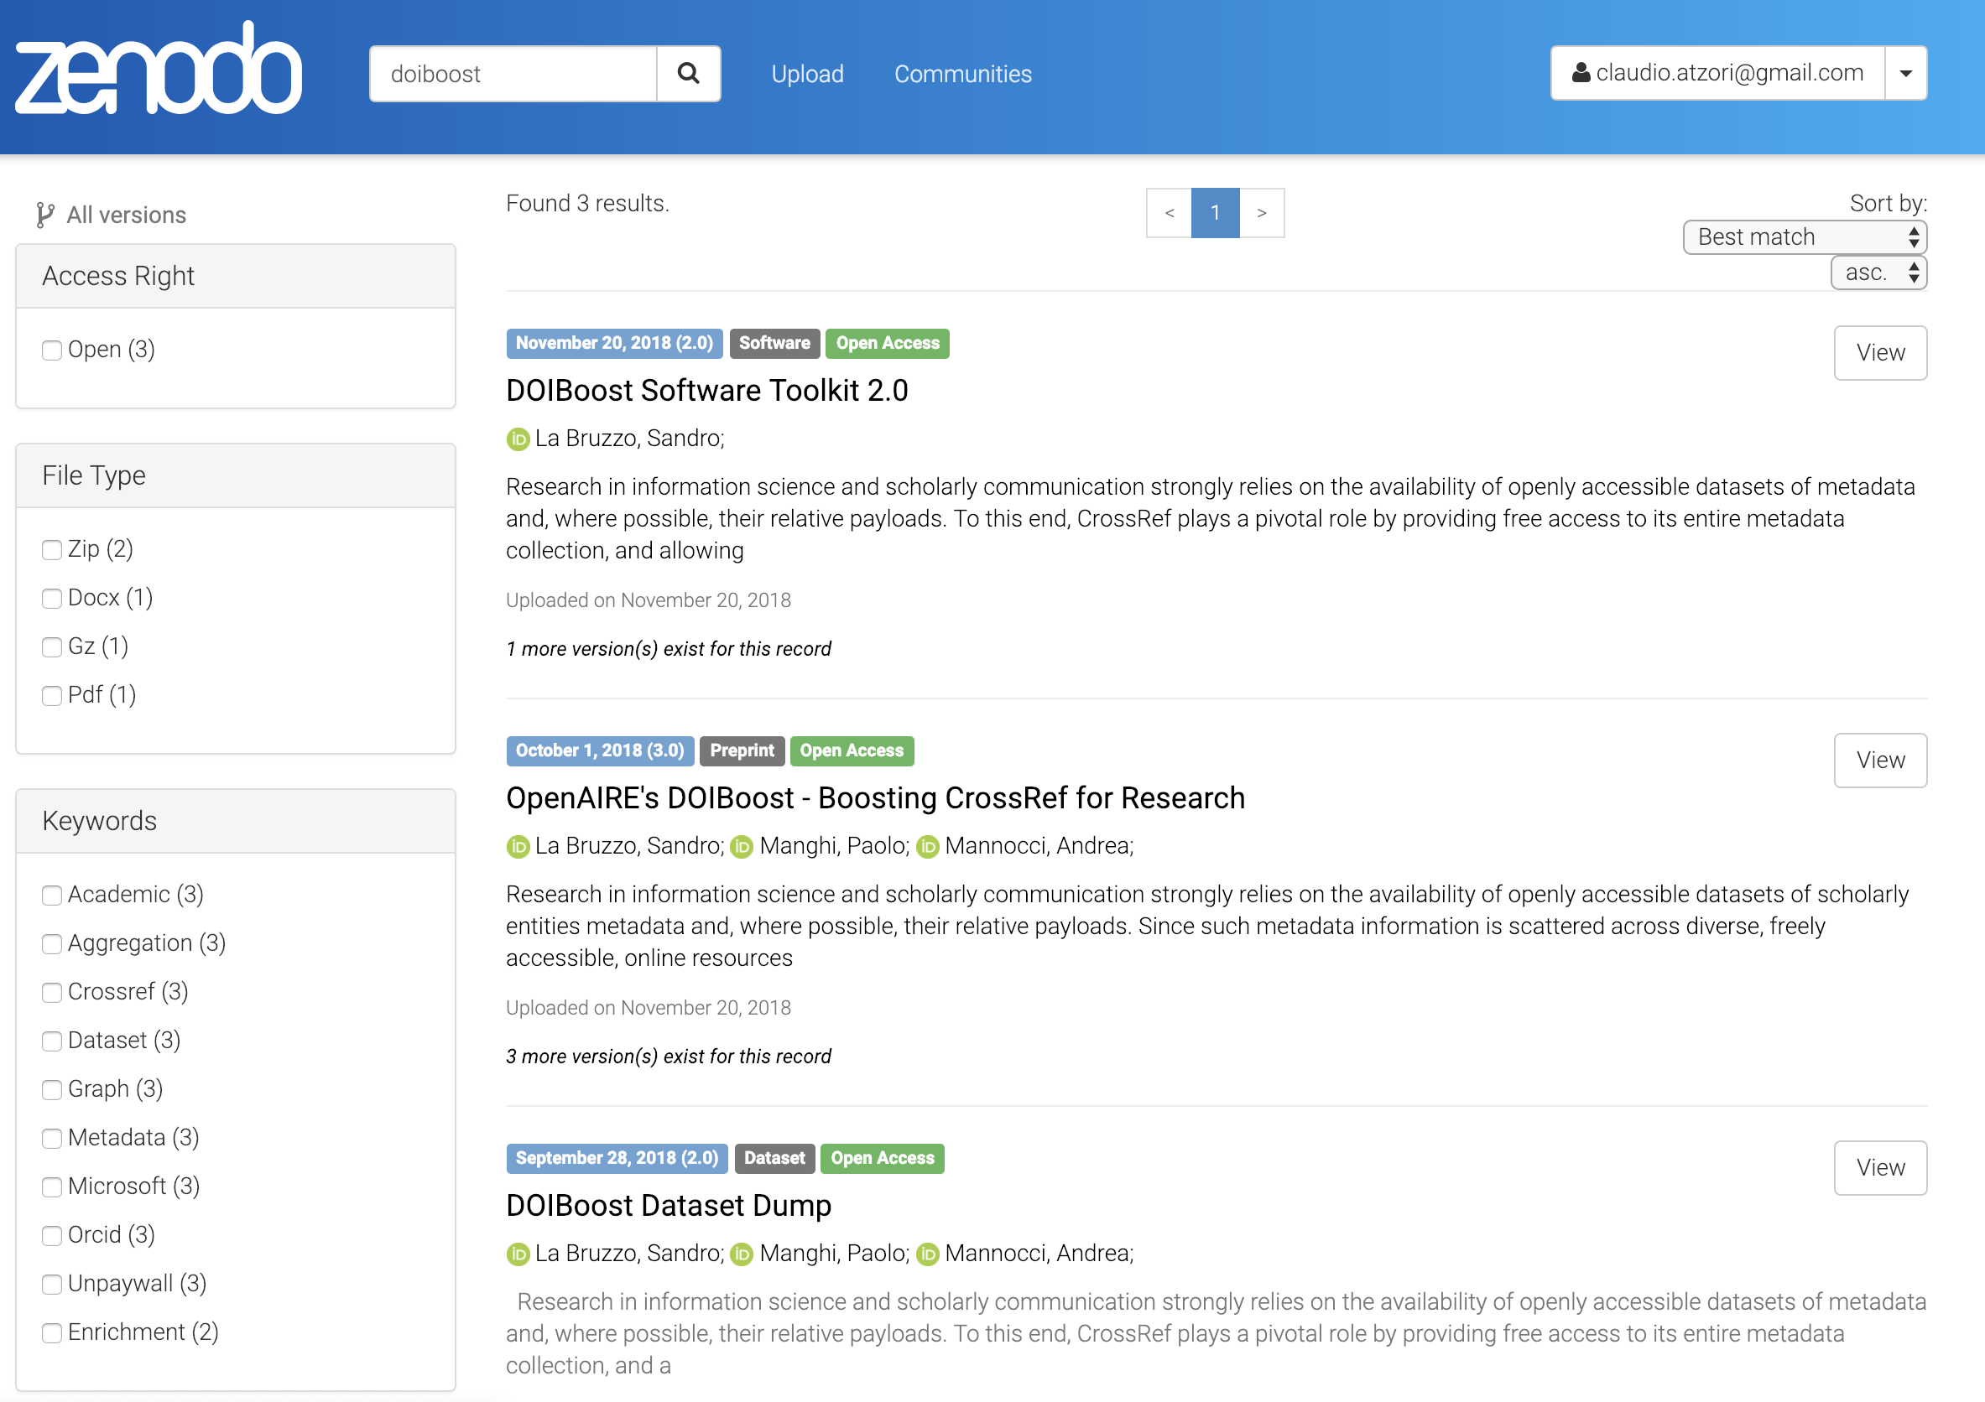
DOIBoost
Result | DOI
Preprint | 10.5281/zenodo.1492766
Software toolkit | 10.5281/zenodo.1492210
Dataset dump | 10.5281/zenodo.1438356
Notes:
Enriched crossref records == DOIBoost
Reproducible activity

Slide 11
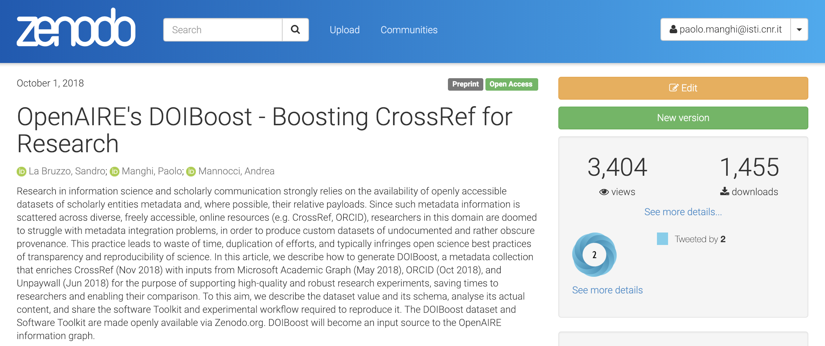
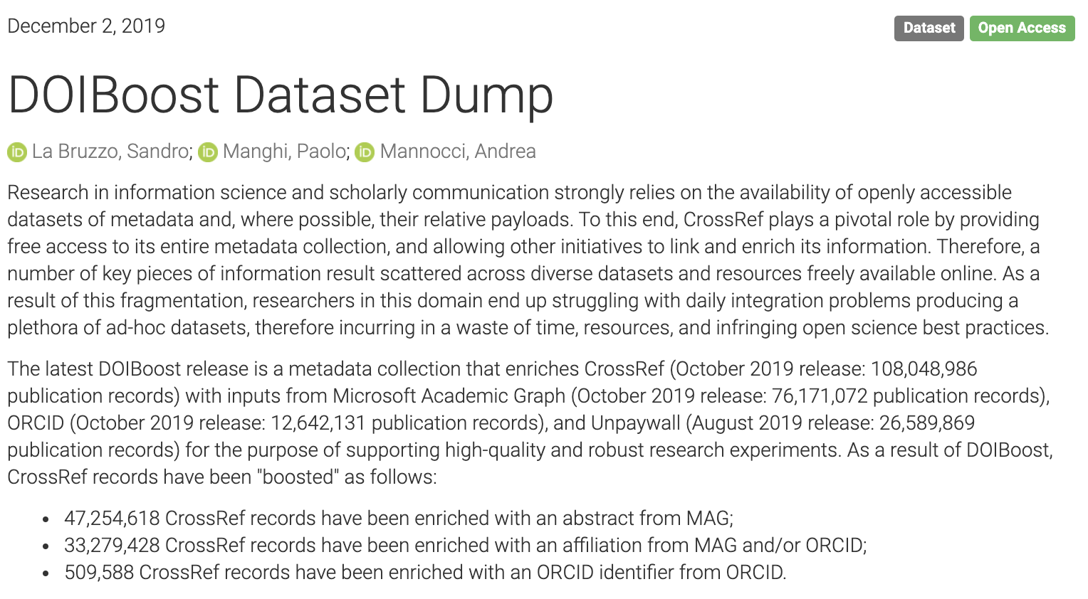
DOIBoost
Notes:
Enriched crossref records == DOIBoost
Reproducible activity

Slide 12
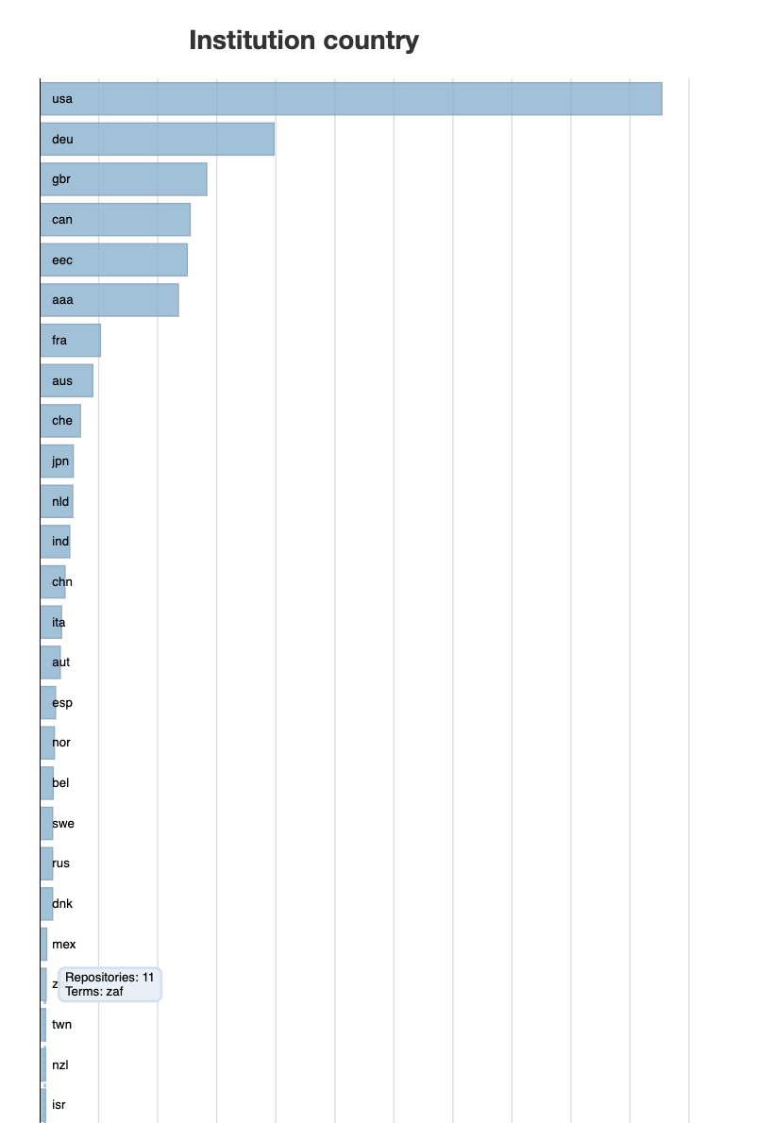
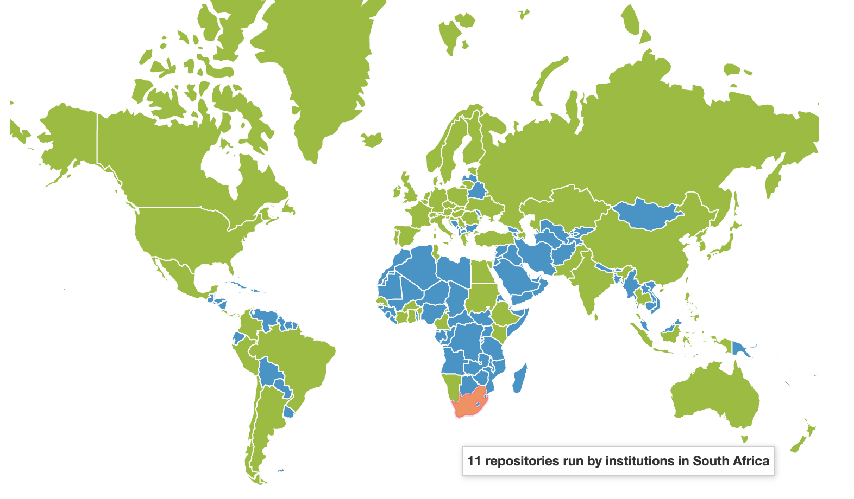

Slide 13


Slide 14
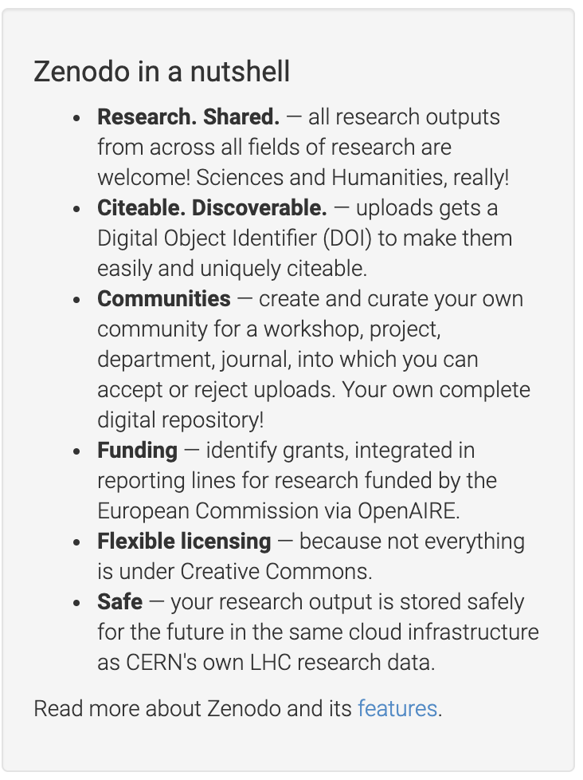
And if you cannot find any thematic/institutional repositories to deposit your data…

Slide 15
Amnesia
Anonymization of sensitive data
OpenAIRE-Advance Review, January 2019

Slide 16
Data anonymization?
Data anonymization facilitates the publication of micro data(vs. aggregated macrodata) , e.g., data used in scientific research
Micro data often reveal important private information, e.g., the medical condition of a person
  Individuals are afraid to provide their data
  Companies are afraid to share data with experts
  GDPR makes a strict protection scheme obligatory
The aim of anonymization methods is to allow sharing such data, without compromising the privacy of the users.
OpenAIRE-Advance Review, January 2019

Slide 17
Amnesia
Amnesia is a data anonymization tool developed by Research Center Athena
Amnesia is built with Java and Javascript
k-anonymity and k^{m}-anonymity
Tuples and set-values
Visual tools
  Estimating data utility
  Building hierarchies
  Customizing anonymization solutions
OpenAIRE-Advance Review, January 2019

Slide 18
Amnesia status
Amnesia is available as a public beta version at
  https://amnesia.openaire.eu
On-line version is for demonstration and testing purposes mostly
Sensitive data can be anonymized locally by downloading the application
  Security
  Scalability
OpenAIRE-Advance Review, January 2019

Slide 19

OpenDMP
Machine actionable open data management planning
Production release
ready soon
OpenAIRE-Advance Review, January 2019

Slide 20
Key characteristics
Supports different models of service provisioning
  cloud (https://argos.openaire.eu) or local installation
Has been implemented taking into account trends and standards on Actionable DMPs, Open Science and experiences from existing tools (RDA)
Used as an entry in research workflows to guide researchers into implementing FAIR
To be a key service for monitoring
Interoperable via APIs for machine-readable DMPs
OpenAIRE-Advance Review, January 2019

Slide 21
Flexible data model: concepts
Dataset profile
A template describing a particular environment with vocabularies and APIs
Contains attributes/fields, behavioral rules (e.g. toggling visibility of fields) and validation rules
Configurable to own needs
  Domain discipline templates
  Domain x funder templates
  …
Dataset description
A dataset described according to a set of rules in a dataset profile
→ Guides to include FAIR by design
OpenAIRE-Advance Review, January 2019

Slide 22


Flexible data model: more structural elements
Data Management Plan
  Collection of dataset descriptions, associated with an activity (“project”)
  Supports versioning
Project
  Logical entity that defines an activity that assembles one or more data management plans
  “grant”, “project”, “initiative” etc.
Users
  PIs, researchers, research managers,
Secondary entities
  Repository: repositories where dataset resides on
  Dataset: external linked datasets
  Registry: catalogues listing the dataset
  Service: services manipulating the dataset under various protocols.
  Researcher: researchers associated with datasets
  …
OpenAIRE-Advance Review, January 2019

Slide 23
Using OpenDMP: Roles
Admins
  select and configure information sources
  define dataset profiles
DMP managers launch DMPs
  select appropriate Dataset profiles
  invite researchers/dataset managers
Researchers/Dataset managers
  describe datasets according to fixed (systemic) and custom (profile-defined) attributes
DMP Managers finalize DMPs
  close the editing process
  publish the DMPs (url, pdf, xml etc)
OpenAIRE-Advance Review, January 2019

Slide 24
Is OpenDMP a questionnaire engine ?
“Definitely No”
Articulated handling of a DMP
  Publishing, discovery, reuse, statistics on DMPs
Actionable DMPs
  Validation of statements via external services
Collaborative DMP composition
  Researchers in the loop
OpenAIRE-Advance Review, January 2019

Slide 25
Questions?

