Slide 1
Framework Workshop
Alessia Bardi
Institute of Information Science and Technologies
National Research Council, Italy

Slide 2
About me
PhD. in Information Engineering at the University of Pisa in 2016
Researcher at the Italian National Research Council since 2009 at the Institute of Information Science and Technologies (ISTI)
Member of the ISTI research group InfraScience (http://nemis.isti.cnr.it/groups/infrascience)
  Lead by Donatella Castelli
  25 among senior and junior researchers, and sys admins (computer science & information engineering)
  Main topics of interest:
    Scholarly communication, Open Access, Open Science
    E-infrastructures for research, Virtual Research Environments
    Aggregative Data Infrastructures

Slide 3

Some of the projects we work(ed) on
Scholarly Communication
Open Access
Open Science
2009 - ongoing
2016-2018
2004-2007
2006-2009
E-infra for research
Virtual Research Environments
2011-2014
2015-2018
2015-2019
2011-2013
Aggregative Data Infrastructures for Digital Humanities and Cultural Heritage
2010-2013
2013-2016
2009-2011
2015-2019

Slide 4


Access – Collaboration – Innovation – Participation
Open Science is the practice of science in such a way that others can collaborate and contribute, where research data, lab notes and other research processes are freely available, under terms that enable reuse, redistribution and reproduction of the research and its underlying data and methods.

Slide 5




How - Scholarly Communication transition to Open Science
Research Infrastructures
Scholarly Communication Infrastructure
Publishing of all kinds of research products and semantic links in between
Publishing experiments themselves to maximize reproducibility
Publishing an up-to-date record of research products metadata and links
Research literature
Articles, docs, white papers
Enabling reproducibility (R*)
Research
data
01101010
01100001
11010010
e-infra Tools &
Services
Research
data
Enabling transparent
evaluation
01101010
01100001
11010010
Open Science
Publishing
Research
Software
Enabling omni-comprehensive scientific reward
Research process
Notes:
HOW: scientific / scholarly communication. To reach researchers as the main users of EOSC, a language of scientific / scholarly communication should be spoken. Excellent researchers do not have time to design infrastructure or temper technology but are eventually targeted towards communicating with peers through publishing any forms of research results, which contribute to their career development.
Despite the hype, the effective implementation of Open Science is hindered by several cultural and technical barriers. Researchers embraced digital science, use ``digital laboratories'' (e.g. research infrastructures, thematic services) to conduct their research and publish research data, but practices and tools are still far from achieving the expectations of transparency and reproducibility of Open Science. The places where science is performed and the places where science is published are still regarded as different realms. Publishing is still a post-experimental, tedious, manual process, too often limited to articles, in some contexts semantically linked to datasets, rarely to software, generally disregarding digital representations of experiments.
However, today’s scholarly communication infrastructure practices, workflows, services, and philosophy still follow traditional article-centric paradigms, where datasets are published in a very similar fashion. To realize an Open Science vision, such as delivery, reproducibility and transparency of science, revolutionary changes in the different phases of scholarly publishing workflows are needed:
Publishing all kinds of scientific products, literature, data, software, other research artifacts.
Publishing semantic links: links between scientific products are increasingly as essential as the products themselves in navigating, understanding, evaluating, and re-using the research life-cycle and its results.
Publishing experiment products, intended as digital representations of the steps of an experiment, including input products, RI services adopted, service configuration, etc.; experiment products should enable the reproducibility of the experiment itself, to facilitate re-use, assessment and evaluation of scientific results;
Automated publishing and assessment: RI services should publish on behalf of the scientists; science should be published not only at the end of the process and should be assessed at intermediate stages (ongoing science), by humans and (where possible) by machines;
Rewarding: identifying measures/indicators for Open Science enables fruitful competition among scientists, whose impact on science should be measured also in terms of how openly they behave;
Monitoring: monitoring Open Science is key for Open Science itself, to ensure its implementation and adjust the aim to establish better policies and incentives.

Slide 6

Open Science publishing vision
Research Infrastructures
Scholarly Communication Infrastructure
Research literature
Articles, docs, white papers
Literature
Repository
Scientists and RI services
Continuous Publishing
Research
data
citation
01101010
01100001
11010010
Data
Repository
01101010
01100001
11010010
e-infra Tools &
Services
Research
data
partOf
01101010
01100001
11010010
partOf
Repeat, Reproduce,
Reuse, Evaluate
Software
Repository
Research
Software
Other products: methods, workflows, protocols
Research process
Provenance: e.g. created by
“Experiment”
Repository
01101010
01100001
11010010
01101010
01100001
11010010
Notes:
Highlight difference between citation and other kinds of relationships

Slide 7
(some of the) Barriers to an effective implementation of Open Science
Culture
Focus (funding) is not on scholarly communication practices
Reward policies
Focus on research literature
Tools
Lack of tools for OS publishing in Research Infrastructures
Dispersion
Research products are scattered across scholarly communication sources
Repository platforms lack support to OS publishing
Research communities lack culture on Open Science publishing
Focus
No best practices for software, experiments, or other products
Links between products are not curated/disregarded

Slide 8





Lines of action
Barrier
Research communities lack culture on Open Science publishing
Action
Training
Barrier
Focus (funding) is not on scholarly communication practices
Action
Support seamless integration with RI services
Barrier
Reward policies focus on research literature
Action
Open Science policies and Open Science ”indicators”
Barrier
Lack of tools for Open Science publishing in RI
Action
Collaboration between repository platforms and RI services
Barrier
Research outcome scattered across repositories and out-dated
Actions
Interoperability framework
Brokering of information
Notes:
Focus on interactions with platforms in order to maximize value, protect data ownership and portability and avoid vendor lock-in
Automate the application of policies supporting OS by design and default, as well as data sovereignty for the user

Slide 9

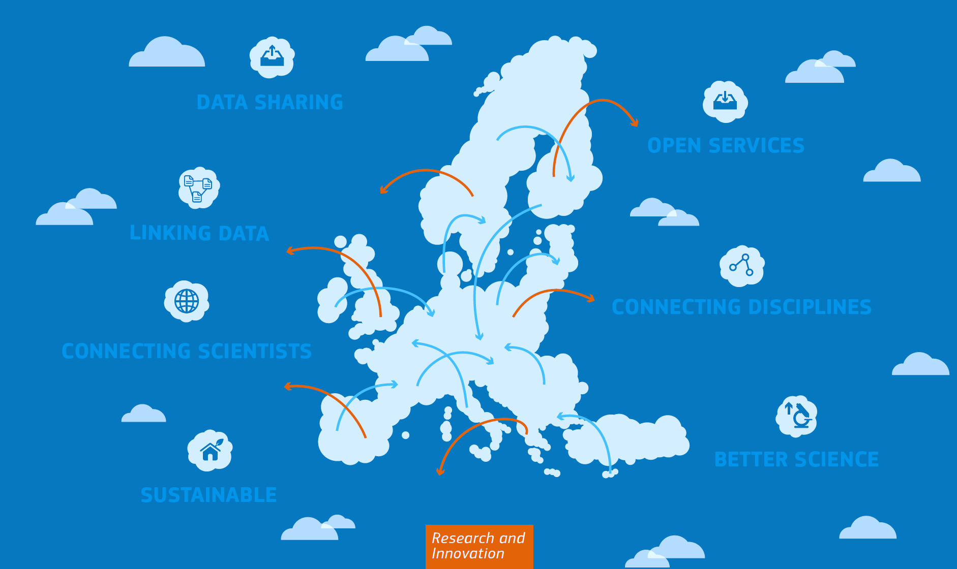



Ongoing in Europe
“1.7 million European researchers and 70 million professionals in science and technology a virtual environment with free at the point of use, open and seamless services for storage, management, analysis and re-use of research data, across borders and scientific disciplines”
European Cloud Initiative (ECI), (COM(2016) 178 final), p.6; Part of the Digital Single Market Strategy
Notes:
EOSC will provide 2 million EU researchers and professionals with a virtual environment for research data management, analysis and re-use across disciplines, increasing the creativity, productivity and reproducibility of research

Slide 10




3 Pillars of Action
Connecting via a Distributed Infrastructure
All types of research outcomes
OpenAIRE is one of the main implementors of the EOSC
Services for Scholarly Communication
Policy Alignment
Training
for OS/FAIR
Aligning
Supporting
Governance
Empowering and Knowledge Building

Slide 11

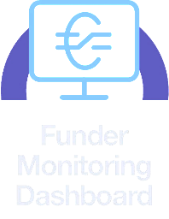
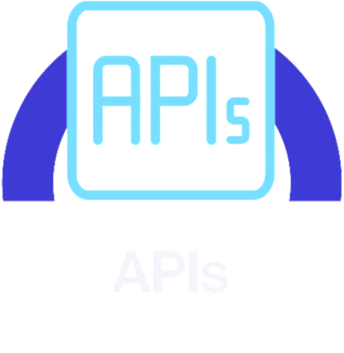
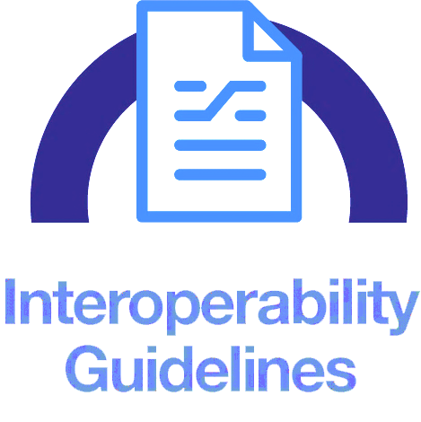



Services for all stakeholders
Monitor
Funders, institutions, RIs, initiatives, 3rd parties
Content providers, Research Infras
Accelerate
Support
Researchers, scientists

Slide 12
